Slide 1

Psicología & Obesidad

Slide 2
Influencias sociales
Normas culturales y sociales
Entorno físico
Obesidad / psicología

Slide 3
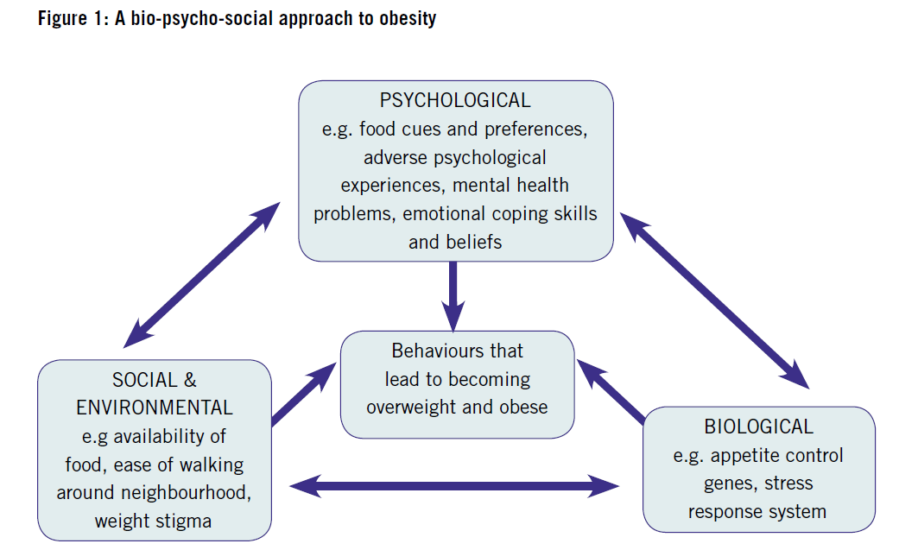
Notes:
Psychologists approach obesity by considering people within the context they live in – their social influences and networks, culturaln and societal norms, as well as the physical environment and physiological factors. This is referred to as the ‘biopsychosocial model’3. Only a biopsychosocial approach can account for the fact that individuals and environments both have an important role to play in the development of obesity and influence each other.

Slide 4
El impacto de estrés
ESTRES
OBESIDAD
Directa
Mayor acumulación de grasa corporal
Indirecta
sensibilidad a las señales, antojos que llevan a comer más o elegir alimentos más densos en calorías.
Notes:
There is a well-established association between stress and obesity in adulthood.7 Exposure to chronic stress, such as financial insecurity, family discord, the stress of being part of a stigmatised group, or mental illness, results in the person’s stress response system being constantly activated. The experience of stress increases the risk of excessive weight gain both directly and indirectly. Chronic activation of the stress response system results in greater accumulation of internal body fat (visceral fat), which is a type of body fat stored in the abdomen and surrounding the internal organs. Stress also influences a range of behaviours, such as sensitivity to food cues and cravings that lead to eating more or choosing more calorific-dense foods.

Slide 5
Estrés persistente
Actividad disminuida en corteza prefrontal (comer sin tener hambre).
Desorganización mensajes de recompensa están asociadas con un mayor consumo de alimentos con alto contenido de grasa y azúcar.
Cambio en hormonas reguladoras de apetito → aumento de apetito
Cansancio e insomnio → sensación de apetito
Notes:
Having a stress response system that is persistently activated has several consequences that influence the tendency to gain weight:
-Reduced activity in the prefrontal cortex, which is responsible for a person’s conscious control of planning and decision making, makes it more likely that people will eat when they are not hungry and have a decreased ability to regulate their diet and eating behaviour.
• Disruptions to the way the brain processes reward messages are associated with increased consumption of foods that are high in fat and sugar.
• Changes to the balance of hormones responsible for regulating appetite compromise our ability to respond to signals associated with being full (satiety), resulting in increased appetite, particularly for high fat and high sugar foods.
• Tiredness as a result of reduced sleep quality or duration means tiredness can make people feel hungrier.

Slide 6
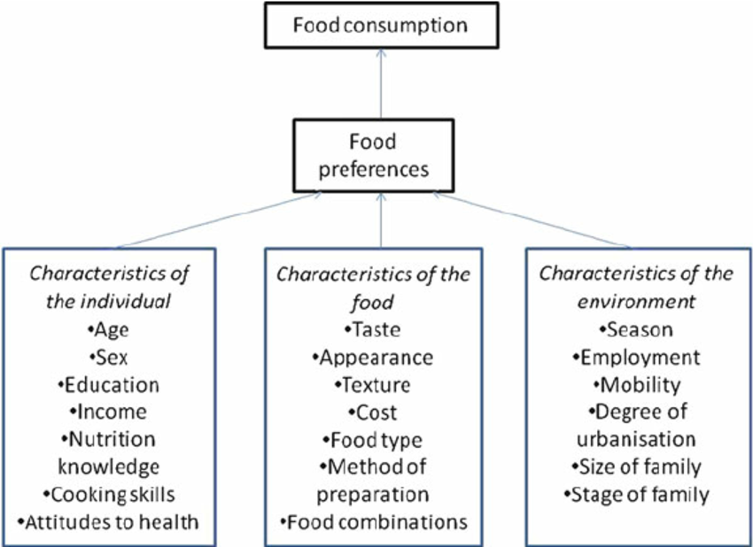
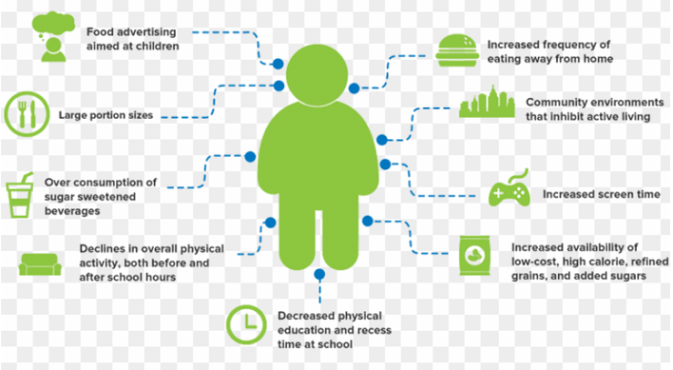
Estado socio económico
Calidad de dieta
Alimentos familiarizados son preferidos y consumidos con mayor frecuencia
Preferencias inician en la infancia hasta edad adulta
Notes:
While it is difficult to separate the uniquely psychological influences on obesity from their biological and social causes, there are a number of cognitive, behavioural and
emotional influences on eating and activity behaviour that are associated with the development of obesity.
Food preferences play an important role in determining what foods people choose to buy and consume. These are shaped significantly by how often people are exposed to certain foods and as a result prefer the most familiar. Food preferences start to develop at the beginning of life and show remarkable stability from childhood through to adulthood. This highlights the importance of how parents feed young children and the need to expose them to a wide range of food choices that include fruit, vegetables and whole grains. The wider food environment also shapes food preferences so that children and adults in poorer neighbourhoods or living in food poverty are more likely to be exposed to more energy dense and nutritionally poor foods.12 This helps to explain the link between socioeconomic status and diet quality.

Slide 7
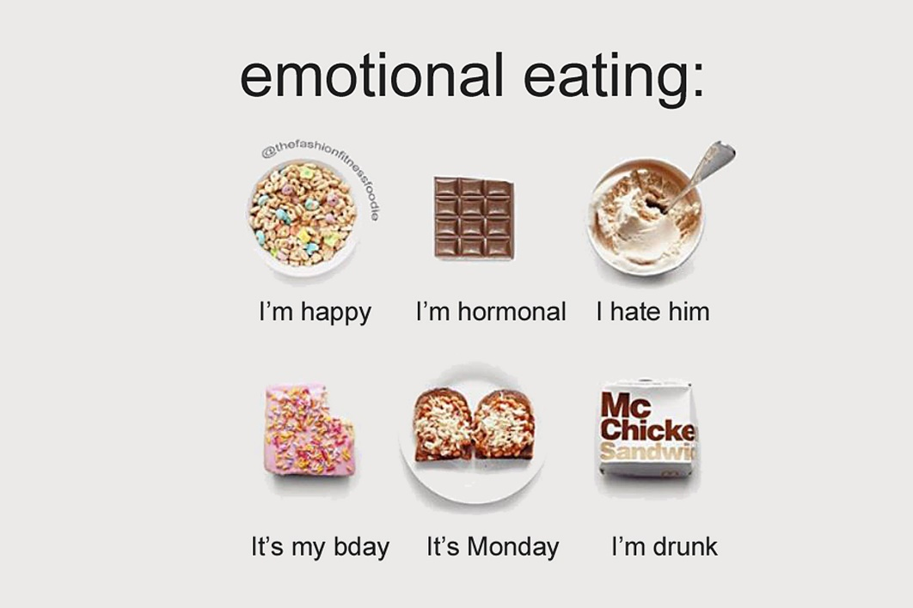


comida
emociones
Comer en respuesta a las emociones, puede volverse un problema cuando es frecuente y regular

Slide 8
Hambre emocional
“The Masking Hypothesis”
La hipótesis de enmascaramiento sugiere que las personas intentan enmascarar las emociones negativas comiendo en exceso para aumentar el estado de ánimo, la comodidad y la distracción a corto plazo.
Notes:
Food and emotions are linked. People use food to respond to positive and negative emotions – to celebrate after a good day or special occasion or to feel better after a bad day. For many people this can be unproblematic. However, eating in response to emotions can become problematic when it is frequent and regular. The Masking Hypothesis suggests that individuals attempt to mask negative emotions by overeating to increase mood, comfort and distraction in the short-term. Those attempting to restrict their eating through dieting behaviour (dietary restraint) are particularly susceptible to emotional eating.
Additionally, the escape theory suggests binge eating is a more extreme form of emotional eating and is a form of escapism from negative self-perceptions and emotional distress. Both emotional eating and binge eating can be used to block out negative experiences temporarily with food but the emotions quickly return.

Slide 9
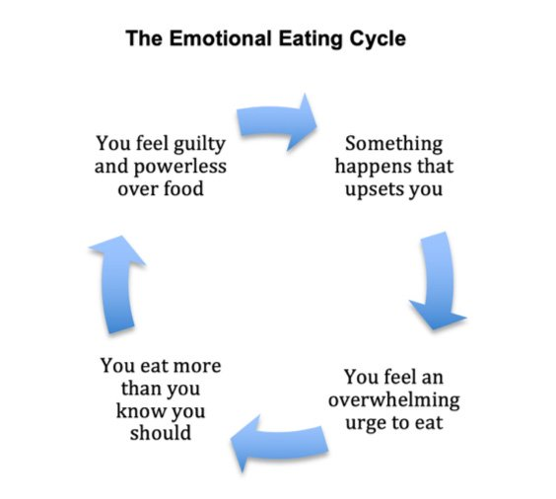
Los atracones son una forma más extrema de comer emocional y de escaper a las percepciones negativas de uno mismo.

Slide 10
Restricciones dietéticas
Restricción dietética
Consumo excesivo
Ganancia de peso
Sentimiento de privación
También puede conducir a un mayor riesgo de otro estado psicológico negativo, como bajo estado de ánimo e insatisfacción corporal, los cuales están asociadas con el aumento de peso y problemas de salud mental como la depresión y los trastornos alimentarios.
Notes:
Restrained eating occurs when someone deliberately tries to reduce their calorie intake then experiences a subjective feeling of deprivation Restrained eating is reliably associated with weight gain over time as attempts to restrain are often resisted by the body resulting in a failure of restraint that leads to overconsumption.
Restrained eating also can lead to an increased risk for other negative psychological state such as low mood and body dissatisfaction, both of which are associated with weight gain as well as mental health problems such as depression and eating disorders.

Slide 11
Salud Mental
Problemas de salud mental aumenta el riesgo de obesidad.
Medicamentos anti psicóticos y anti depresivos aumentan el apetito
Trastorno por atracón
3.5% prevalencia
Salud mental Obesidad
Notes:
While the relationship between the presence of mental health problems and obesity is complex and bi-directional, the experience of a variety of mental health problems increases an individual’s risk of obesity. Individuals with a serious mental illness (SMI) have much higher levels of obesity. Since obesity often involves serious physical and
psychological problems, there would ideally be an integrated approach to care across all services.
For example, given that some anti-psychotic and anti-depressant medications increase appetite, health professionals prescribing to people with obesity should also consider the potential for different medications to affect activity levels and weight gain. There are distinct psychological problems such as Binge Eating Disorder (BED) in which behaviours such as ingesting large amounts of food in a short time without compensatory purging or exercise behaviour leads to weight gain. The prevalence of BED in the general population is approximately 3.5 per cent,24 it is significantly higher for individuals seeking medical help for weight loss. The increased risk of developing obesity among those with mental health problems cannot explain all the dramatic shift in the proportion of the population who are living with obesity. Nevertheless, people with mental health problems may be more at risk of obesity and vice versa.

Slide 12
Se han asociado experiencias infantiles adversas como abuso, un padre o cuidador que experimenta estrés, enfermedad mental, trauma y conflictos familiares. con el aumento de peso.
Hasta la mitad de los adultos que asisten a consulta en obesidad experimentaron adversidades o traumas en la vida adulta.
Dificultades emocionales y de comportamiento
Notes:
Adverse childhood experiences (ACEs) such as abuse, a parent or caregiver that experiences stress, mental illness, trauma, and family conflict have all been associated
with behaviours that are known to be related with weight gain. The causal pathways between adversity in childhood and excessive weight gain are complex.
They reflect reciprocal influences between how parents and carers feed their children, how children respond to such feeding, as well as various social and cultural factors that shape one’s relationship with food, eating pattern and activity behaviour over a child’s development. Psychological adversity in childhood is a common cause of a range of emotional and behavioural difficulties in adolescence and adulthood, some of which may influence weight gain directly through the influence of the eating styles, such as restrained or emotional eating and a lack of motivation towards engaging in physical activity. The experience of stress as an adult, caused by factors like financial insecurity and mental illness, has also been linked to an increased risk of obesity28. Up to half of adults attending specialist obesity services may have experienced childhood adversity or trauma in adult life

Slide 13
Actividad física y sedentarismo
La disminución de la actividad física en entornos ocupacionales y de ocio ha contribuido al aumento de las tasas de obesidad
Los cambios en la forma en que se construyen nuestros entornos físicos han impactado en la motivación y la capacidad de las personas para realizar actividades físicas
Notes:
Technological advances in transportation and mechanisation have reduced the amount of physical activity required to perform a variety of tasks on a day-to-day basis, while sedentary screen-based activities have increased. Declines in physical activity in occupational as well as leisure settings have contributed to increased obesity rates. At the same time, changes to the way our physical environments – homes, offices and public spaces – are built have impacted on how motivated and how able people are to engage in physical activity, such as how easy people feel it is to walk around the neighbourhood.
Jobs have become more sedentary and involve more screen use, which curtails people’s opportunities for everyday activity. However, there is evidence that suggests that
changes to the work place, such as active workstations, could help to reduce inactivity at work without impacting on productivity. Studies show that clients who are obese
commonly report taking 2000–3000 fewer steps per day than those in the healthy weight category (BMI <25)

Slide 14
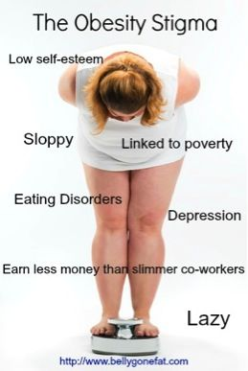
Estigma y Discriminación
La vergüenza no motiva a las personas ni ayuda para hacer cambios sostenibles en su vida.
Vergüenza
Ganancia de peso
Una forma de lidiar con estrés es usar alimentos para distraer, calmar o anestesiar sentimientos incómodos, pero confiar en esta estrategia de afrontamiento aumenta el consumo y el peso de los alimentos.
Notes:
lives. In fact, weight stigma perpetuates a cycle of shame and weight gain at all levels of obesity. As a person’s Body Mass Index (BMI) increases, so does their perception
of discrimination towards them because of their weight. To understand and address obesity we must acknowledge and understand weight stigma. It is an important social and environmental factor that contributes to behaviours that lead to obesity. A view that positions the causes of weight gain as residing within individuals has
resulted in a widespread cultural view that obesity is a negative personal characteristic. Public acceptance of this stereotype allows individual, group and organisational weight bias and discrimination to go unchallenged, in a way that other forms of discrimination do not. This has an impact not only on individual experiences but also on the way that policies and support services are designed. Being stigmatised is stressful. It can lead to feelings of distress, shame, guilt and failure. One way of coping with this stress is to use food to distract, soothe or anaesthetize uncomfortable feelings, but relying on this coping strategy increases food consumption and weight. Evidence has shown that stress results in biological, psychological and social mechanisms that maintain weight gain, including increased appetite, eating behavior changes and weight.

Slide 15
El estigma de peso para los adultos puede conducir a un mayor riesgo de alteración de patrón alimentario y trastornos alimentarios
Riesgo de trastorno por atracón
Miedo o fobia de salir de su hogar, abuso
Rechazo social (en el trabajo)
Mujeres en mayor riesgo
Notes:
Similarly, weight stigma for adults can lead to an increased risk of disturbed eating patterns and eating disorder symptoms and an increased calorie intake while simultaneously feeling out of control with eating. It can lead to an increased risk of binge eating. It can prevent people from attending local weight management services that do exist, or even leaving their home for fear of abuse, so it is less likely they will get the support they need. Stigma can interfere with people’s ability to engage in physical activity. It contributes to poor body image and anxiety about discrimination that compounds the problem of people avoiding exercise. Physical and emotional wellbeing can be severely impacted in terms of lowering of mood and self-esteem and higher levels of depression. When people internalise weight bias, it is associated with poorer physical and mental health outcomes and a reduction in both physical and mental health and quality of life independent of age, BMI and medical conditions. Stigma has also been shown to lead to discrimination at work,especially for women

Slide 16
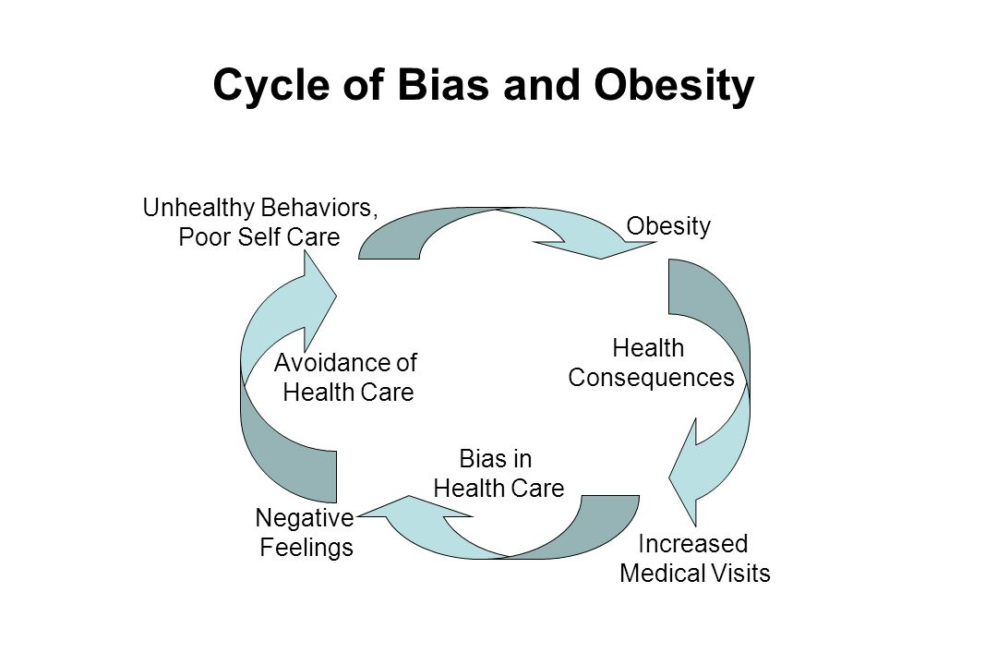
El estigma de peso es particularmente dañino en entornos de atención médica, complicando el mecanismo destinado a resolver el problema.
Interfiere con la relación médico-paciente
Les preocupa que no sean tomados en serio y los deja reacios a abordar sus problemas de peso.
Notes:
Implicit or explicit prejudice against people who are an unhealthy weight affects the way services are designed and delivered. Weight stigma is particularly harmful in
healthcare settings because it complicates the mechanism that is meant to solve the problem. People living with obesity rely on healthcare services, but the inherent weight bias from those who have designed and who work within such services means that they can receive poor levels of care and experience greater physical and psychological adversity as a result. Weight stigma interferes with the relationship between a patient and their healthcare provider. It can leave people feeling belittled,
berated and disrespected. It makes them worry that they will not be taken seriously and leaves them reluctant to address their weight concerns. Given that many people with obesity are highly sensitive to stigmatisation, insensitive remarks from a health care professional can disrupt the relationship and patient adherence to treatment.

Slide 17
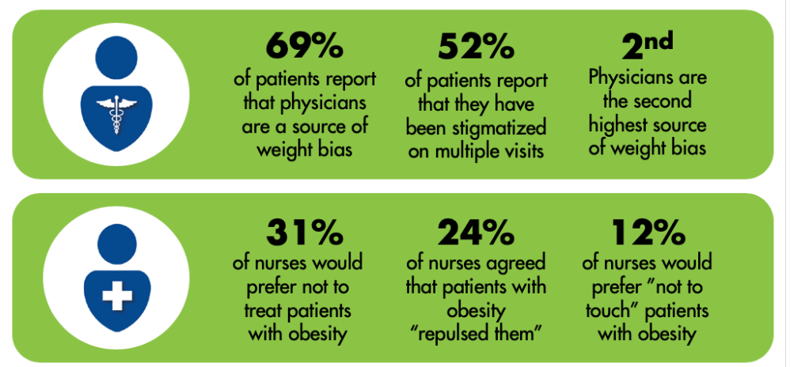

Se ha descubierto que la capacitación para profesionales de la salud que incluye proporcionar una comprensión de las complejidades biopsicosociales asociadas con el peso reduce el estigma del peso.
Notes:
Training for healthcare professionals that includes providing an understanding of the biopsychosocial complexities associated with weight has been found to reduce weight stigma. For example, watching short videos about weight stigma improved negative judgments of people living with obesity, reduced the viewer’s desire for
social distance from people living with obesity, and supported equal rights

Slide 18
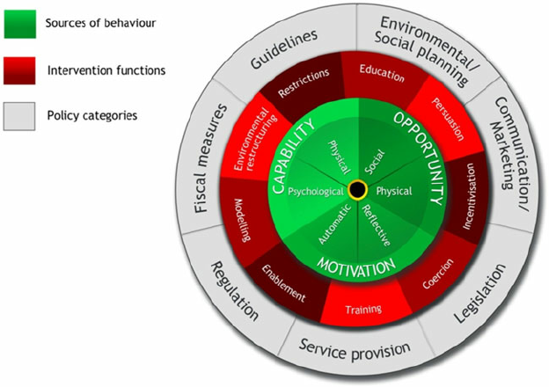
Cambios en el comportamiento
El cambio de comportamiento es fundamental para la prevención, el manejo y el tratamiento de la obesidad.
Comportamientos están influenciados por una combinación de factores biológicos, psicológicos y sociales, y no son responsabilidad exclusiva del individuo.
BEHAVIOUR CHANGE WHEEL (2011).
Distintas formas de de intervenciones para cambio de comportamiento
Notes:
Behaviour change is central to the prevention, management and treatment of obesity. To reverse the trend of increasing obesity rates over the past decades, large-scale population level behaviour change is needed. Achieving this will require an integrated, evidence based approach that recognises behaviours are influenced by a combination of biological, psychological and social factors, and are not solely the responsibility of the individual. One such framework is the Behaviour Change Wheel (BCW), developed by Health Psychologists Michie, West and van Stralen in 2011. The BCW brings together 19 different frameworks of behaviour change interventions
into one model to help practitioners understand and influence the drivers for change. At the centre of the BCW is the ‘COM-B model of behaviour’.

Slide 19
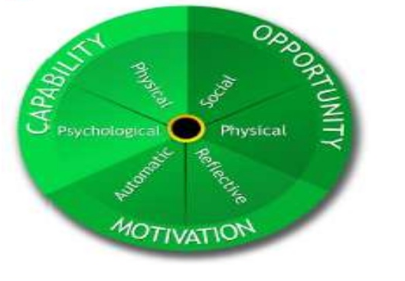
COM-B
Establece que el cambio de comportamiento depende de si un individuo tiene:
Capacidad de hacer el cambio
Oportunidad de hacer el comportamiento
Motivación
Notes:
The model sets out that behaviour change relies on whether an individual has the Capability to enact the
behaviour (e.g. the physical and psychological skills, knowledge and abilities); whether their social and physical environment offers them the Opportunity to enable the behaviour; and if they have the Motivation to perform or avoid the behaviour. These components interact to determine whether a desired behavior happens. Interventions must impact one or more of these components to change behaviour. Once the influences on a desired behaviour are understood, the Behaviour Change Wheel can be used to design interventions to change those influences (through intervention functions) and then embed those interventions to enable long-term change (using policy functions) at different levels.

Slide 20
Ofrece diferentes "Funciones de intervención" que se dirigen a diferentes componentes de un comportamiento deseado.
Educación, entrenamiento, restricciones, persuasión, estímulos
La capa externa de la rueda identifica siete "Categorías de política", (apoyan las intervenciones)
Legislación, prestación de servicio, lineamientos ó guías
Notes:
It builds on the COM-B model by offering different ‘Intervention Functions’ that target different components of a desired behaviour. These intervention functions include
education, training, restrictions, persuasion and incentives. The outer layer of the wheel then identifies seven ‘Policy Categories’, such as legislation, service provision, regulation or guidelines that can support the delivery of These interventions, generally at population level.
In practice, this has enabled reviews of obesity interventions to be carried out and help indicate which BCTs are likely to be most effective in different settings
and populations.

Slide 21
Comer hace más que mantenernos vivos, satisface una variedad de necesidades sociales y psicológicas. Para muchos, comer en exceso se ha desarrollado como una forma de regular las emociones y hacer frente a la angustia emocional.
PSICOLOGIA.
medicación o cirugía
Notes:
Eating does more than keep us alive, it meets a range of social and psychological needs. For many, over-eating has developed as a way to regulate emotions and cope with emotional distress. So, for some people who are living with obesity, strategies to support weight loss and maintenance need to go beyond simply promoting new healthy behaviours. When lower-intensity interventions have proven unsuccessful, psychological input is always needed, particularly if medication or surgery is
being pursued as a course of treatment.

Slide 22

La cantidad de peso que se necesita perder para lograr un peso saludable puede parecer inalcanzable
Consecuencias emocionales y físicas (dolor, depresión, aislamiento social, baja de autoestima)
Notes:
People who are obese can experience years of stigmatisation (see chapter two) which damages their self-esteem. Many people who are obese
have dieted in the past and lost weight only to regain it, which is demoralising and makes weight loss seem futile. This is worsened by the fact that the amount of weight needing to be lost to achieve a healthy weight can seem unachievable. Obesity often adversely impacts health and wellbeing, which leads to additional
problems, including common consequences of chronic health conditions such as pain, depression, anxiety, social withdrawal, reduced motivation and reduced self-esteem.

Slide 23
Cambiar la visión en su problema de peso
Intervenciones pueden abordar autoestima y fomentar estilos de vida saludables en lugar de hacer dieta.
Notes:
Psychological input to obesity interventions can help people address these difficulties by helping them change their view of their weight problem. Interventions can address self-esteem and self-efficacy, help individuals to cope with the re-emergence of old habits, especially under stress, tackle unhelpful thoughts and beliefs about themselves and encourage healthy lifestyles rather than dieting. Interventions should provide clients, teams and systems with an integrative formulation in order to understand the complex interplay of challenging environments, emotional dysregulation and the use of food to cope with emotional distress.

Slide 24
NICE , SIGN recomiendan que todos las intervenciones de control de peso incluyen un componente psicológico.
La inclusión de psicología para programas de prevención y tratamiento debe ser central, en lugar de un complemento
Notes:
NICE , SIGN recomiendan que todos las intervenciones de control de peso incluyen un componente psicológico. Esto significa que las intervenciones deben basarse en el comportamiento evidencia de cambio y evidencia psicológica en el diseño o la presencia de un psicólogo con experiencia en trabajar con traumas niveles.
Interventions should be matched to the specific needs of groups and individuals, with increasingly comprehensive and intensive programmes available to those with complex and enduring obesity. Effective interventions can be life-changing for individuals living with obesity, as well as dramatically reducing the associated health and social care costs. The inclusion of psychological evidence and psychologists in service design, delivery, evaluation and training for prevention and treatment programmes must be central, rather than an add-on.

Slide 25
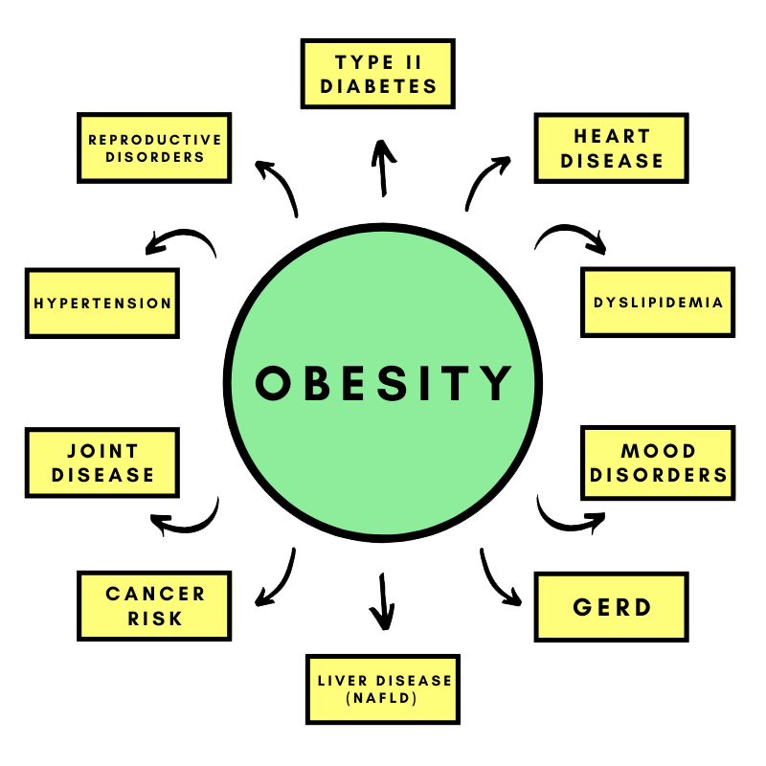
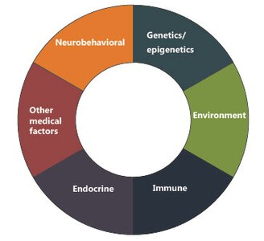
Complicaciones relacionadas (ó exacerbadas) con obesidad
Enfoque en las complicaciones
¿Por qué una persona persiste con los comportamientos que mantienen la obesidad a pesar de los graves problemas de salud ?
Notes:
Specialist weight management services for adults are generally offered to individuals with a BMI of 40 or above, who have been unsuccessful in addressing their obesity via other structured interventions like community based healthy eating or physical activity programmes and commercial slimming programmes. Many have complications fro other long term conditions that are exacerbated by their high BMI. Often the physical complications are severe, so consequently the focus of interventions is on the medical management of them, with psychology being seen as of secondary importance. Sometimes this is appropriate, but sometimes it can ignore the key underlying question of why a person should persist with behaviours maintainingobesity despite very serious health problems?

Slide 26
La mitad de los adultos que asisten a consulta han experimentado adversidades o traumas que agrava la vergüenza y el estigma relacionados con el peso.
Los desafíos de vivir con obesidad pueden ser traumáticos.
Vivir con obesidad es un desafío.
Notes:
When psychological issues are explored, often it turns out that there are reasons for this that are amenable to psychological interventions.
Specialist multidisciplinary teams should be available for children and young people living with obesity, particularly those with complex needs and serious co-morbidities, and should incorporate psychological assessment while involving wider family members where possible. Up to half of adults attending specialist obesity services may have experienced adversity or trauma in childhood or adult life, one of the psycho-social causal factors as outlined previously in this document, compounding weight related shame and stigma. Moreover, the challenges of living with obesity can themselves be traumatic. It is essential that these services provide a psychologically informed assessment at the start of the intervention, undertaken either by a practitioner psychologist with experience of obesity or a health professional trained, supervised and supported to develop a psychological ‘formulation’ of the individual’s obesity related precipitating and perpetuating concerns.

Slide 27
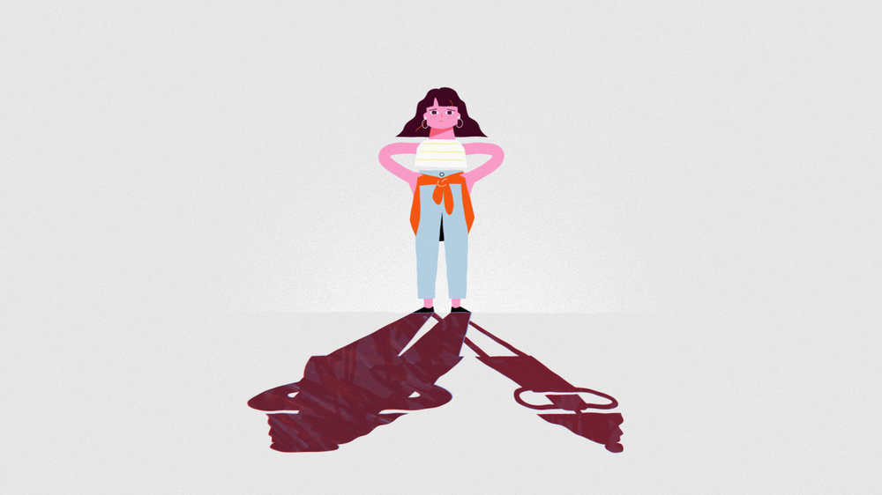

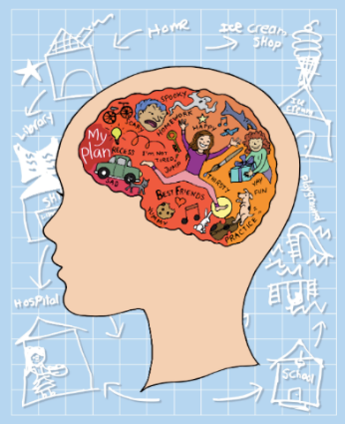
Los trastornos alimentarios son un importante componente para asistencia a consulta de control de peso, y se puede reducir significativamente a través de intervención psicológica
Notes:
Adults with severe and enduring mental distress and adults with learning difficulties both have an incidence of obesity much higher than the general population. The evidence indicates that such individuals can benefit from weight management programmes similar in content to those outlined above, but interventions should be tailored to support engagement. However, very few of these services for these vulnerable populations currently exist. The problematic consequences for obesity apply all the more so to vulnerable populations whose other severe problems may be felt to make obesity less of a priority.
Eating disorders such as bulimia, night eating syndrome, and binge eating, are a significant component of obesity for many attending specialist weight management services, and can be significantly reduced through psychological intervention.166

Slide 28

La cognitiva conductual (TCC) se relaciona a una pérdida de peso clínicamente significativa.
La pérdida de peso moderada se asocia con mejoras significativas en el estado de ánimo y la calidad de vida.
Notes:
Specialist services that use behavioural therapy and cognitive behavioural therapy (CBT) report clinically significant weight loss. Comparisons between programmes are difficult because of methodological differences in programme lengths and modality and significant BMI differences between the population participating. Evaluation should go beyond simple measures of weight lost to include a broader range of outcome measures including behavioural change, indicators of well-being such as mood, quality of life and biological markers of health risk, and health economic indicators like reduction in medication and return to employment. Moderate weight loss is associated with significant improvements in mood and quality of life.

Slide 29
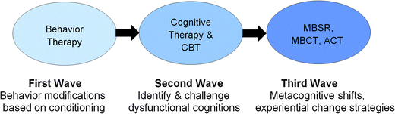
Habilidades en la regulación emocional para cambios en el comportamiento y en el desarrollo a largo plazo.
Notes:
Sin embargo, en casos donde un individuo no responde bien al primero línea de intervención y donde su formulación sugiere que se beneficiarían, nuevo intervenciones psicológicas con emergente La evidencia también puede ser considerada. Estas son conocidos como "Third Wave CBT" e incluyen habilidades en mindfulness, regulación de emociones, compasión, cambio de comportamiento y largo plazo mantenimiento y ayudar a las personas a desarrollarse vidas más satisfactorias.170 Esta área en desarrollo de tratamiento está mostrando potencial. Más lejos investigación, por ejemplo, aleatorizado multicéntrico ensayos controlados que comparan terapias emergentes con la TCC tradicional es necesaria para desarrollar esto base de evidencia para que pueda incorporarse en orientación para dar forma a futuros servicios.

Slide 30

Psicología y Cirugía Bariátrica
La cirugía bariátrica es un procedimiento psicológicamente exigente y los resultados positivos a largo plazo dependen de que las personas cambien significativamente su comportamiento tanto antes como después de la cirugía y su capacidad para desarrollar nuevas habilidades de afrontamiento.
Notes:
Bariatric surgery is a psychologically demanding procedure173 and positive longterm outcomes depend on people significantly changing their behaviour both before and after the surgery and their ability to develop new coping skills. Surgery is most effective in the long-term when broader psychological aspects of weight, eating and physical activity behaviours are also addressed in Tier 3 specialist obesity services beforehand.

Slide 31
Cirugía Bariátrica
Cambios en el estilo de vida
Preparación psicológica
Cambios positivos a largo plazo
Notes:
National guidelines recommend that
individuals who are considering bariatric surgery should complete behavioural lifestyle interventions, such as those offered by
specialist obesity services, in addition to more in-depth psychological assessment to ensure they are psychologically ready for the procedureand maintain the positive gains in the longterm.

