Slide 1
Historia Cirugía Bariátrica
Procedimientos malabsortivos
Notes:
.

Slide 2
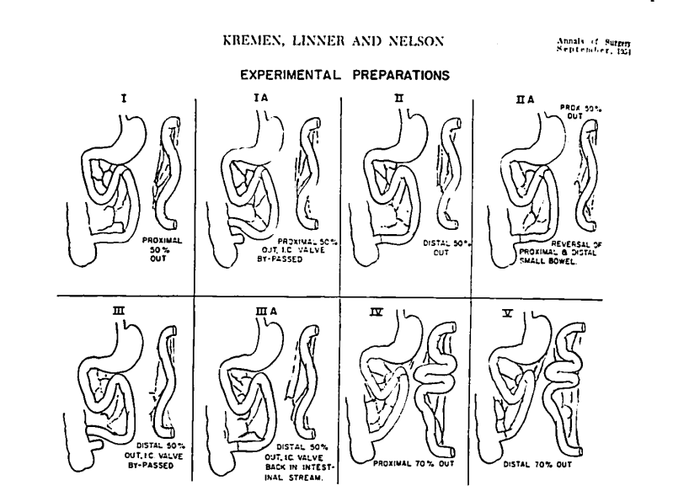
1954, Kremen & Linner
Acortamiento intestinal + malabsorción= pérdida de peso
Notes:
The initial era of bariatric surgery began with the observation that a surgically shortened small intestine and secondary malabsorption resulted in sustained weight loss. In 1954, Kremen et al. reported that resection of a controlled length of small intestine in dogs resulted in impaired fat absorption and consequent weight loss. They also noted that those patients who lost a portion of their small intestine for various reasons lost weight despite increased caloric intake. These observations cultivated the beginning of bariatric surgery as we know it today. Because the majority of nutrient absorption occurs in the small intestine, it was the first region of the gastrointestinal tract considered
for surgical revision to produce weight loss. The small intestine normally measures approximately 550 cm in length. A significant decrease in the functional absorptive length of small intestine can result in impaired absorption of nutrients and “dumping syndrome” associated with certain food intake. Dumping syndrome can result in diarrhea, nausea, and bloating.

Slide 3
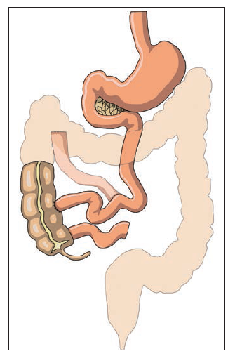
Bypass Yeyuno - cólico
1963, Payne et al. realizaron el primer procedimiento quirúrgico de pérdida de peso en pacientes con obesidad.
Bypass yeyuno-colon a 30-50 cm ligamento de Treitz, anastomosis termino-lateral. Modificación: anastomosis yeyuno a colon ascendente para disminuir diarrea.
Pérdida de peso (mayor) el primer año post operatorio
Disminución de colesterol, lipoproteínas
Diarrea, esteatorrea
Malabsorción: Vitamina B12, A, D. Niveles bajos de Mg, K, Ca.
DeshidrataciónDHE, Hipo protrombinemia, hipotensión ortostática, tetania
Colelitiasis, nefrolitiasis, Esteatosis hepática → Cirrosis hepática → Falla hepática
Nguyen et al.. (2015). The ASMBS Textbook of Bariatric Surgery: Volume 1: Bariatric Surgery. 10.1007/978-1-4939-1206-3.
Notes:
In 1963, Payne et al. performed the first surgical procedure for weight loss in obese patients. The jejunocolic bypass, a purely malabsorptive procedure, consisted of dividing the small intestine 35–50 cm distal to the ligament of Treitz. The proximal segment was then anastomosed to the proximal transverse colon in an end-to-side fashion. The distal end was simply closed blindly, leaving a long blind loop of small intestine. This procedure was later modified to include anastomosis of jejunum to proximal ascending colon to help decrease the degree of diarrhea (Fig. 1). After the surgery, the majority of weight loss occurred in the first postoperative year. In all subjects, decreased absorption of fats and resultant decreased serum cholesterol and lipoproteins was noted. However, fatty stools, significant diarrhea, and anal complications were observed in nearly all patients. These findings were seen for many years after surgery, even when the patients’ weight had stabilized. Poor absorption of vitamins B12, A, and D and low levels of such minerals as magnesium, potassium, and calcium also occurred, which required continuous replacement. Other complications included dehydration, electrolyte imbalance, hypoprothrombinemia, postural hypotension, tetany, joint symptoms, anemia, cholelithiasis, nephrolithiasis, fatty infiltration of the liver, hepatic cirrhosis, and hepatic failure. Because of severe complications, jejunocolic bypass was abandoned, and many were converted to jejunoileal bypass.

Slide 4
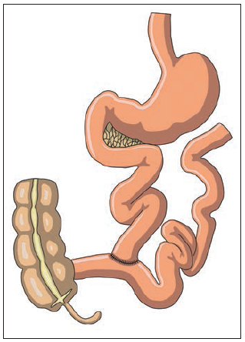
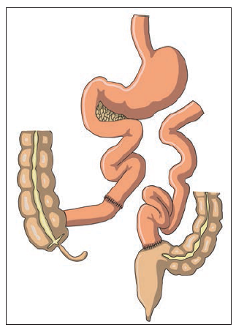
Bypass Yeyuno-ileal
1969, Payne & DeWind recomendaron bypass yeyuno-ileal como tratamiento quirúrgico de la obesidad.
División a 35 cm ligamento de Treitz, anastomosis a íleon terminal
1976, Scott Jr; anastomosis termino-terminal yeyuno—ileal
Asa intestinal a colon sigmoides
Pérdida de peso (mayor) primer año post quirúrgico.
Grado de obesidad determina tiempo requerido para alcanzar el peso deseado.
Nguyen et al.. (2015). The ASMBS Textbook of Bariatric Surgery: Volume 1: Bariatric Surgery. 10.1007/978-1-4939-1206-3.
Notes:
In 1969, Payne and DeWind [10] recommended jejunoileostomy for surgical treatment of obesity. This procedure involved dividing the small intestine 35 cm distal to the ligament of Treitz and anastomosing the proximal segment of jejunum to the terminal ileum, 10 cm proximal to the ileocecal valve in an end-to-side fashion (Figs. 2 and 3). In 1976, Scott Jr. et al. recommended an end-to-end anastomosis of the jejunum to ileum, where the bypassed long segment of the small intestine was anastomosed into the transverse or sigmoid colon (Fig. 4). Investigators claimed better weight loss and maintenance because of lack of reflux of nutrients into the bypassed small intestine, which was present in the end-to-side jejunoileostomy [12] (Fig. 5). Although the long-term weight loss differed with both variants of the jejunoileal bypass procedures, the majority of patients lost a significant amount of weight within the first postoperative year. Pi-Sunyer reported that the degree of the patient’s obesity determined how closely the desirable weight would be achieved; the heavier the patient, the earlier a weight plateau would occur. Jejunoileal bypass, however, was associated with several
significant complications as well.

Slide 5
“Bypass enteritis”, / Síndrome enterohepático sobrecrecimiento bacteriano (anaerobios)
Poliartralgia, falla hepática (toxinas)
Fisura, fistula anal, hemorroides (diarrea)
Síndrome intestino corto, malabsorción ácidos grasos, calcio (nefrolitiasis, falla renal)
K, Ca, Mg; neuropatía, desmineralización ósea, mialgia, edema.
Re ganancia de peso (continua malabsroción)
Nguyen et al.. (2015). The ASMBS Textbook of Bariatric Surgery: Volume 1: Bariatric Surgery. 10.1007/978-1-4939-1206-3.
Notes:
Anaerobic bacterial overgrowth in the long excluded blind loop, termed “bypass enteritis,” resulted in abdominal distention and lactose intolerance and contributed to the foulsmelling flatus and stool commonly observed in these patients. Absorption of the bacterial toxins resulted in polyarthralgia and hepatic failure. Continuous diarrhea also resulted in anal excoriation and hemorrhoids [13]. In addition to short gut syndrome, alterations to luminal absorption of fatty acids, calcium, and oxalate led to increased incidence of nephrolithiasis and renal failure. Loss of potassium, calcium, and magnesium, as well as vitamin and protein deficiency, resulted in secondary neuropathy, bone demineralization, myalgia, peripheral weakness, and edema [14]. As adaptation to the short gut syndrome progressed, the capacity to absorb carbohydrates increased, which resulted in weight regain despite the continuous protein malnutrition and malabsorption of vitamins and minerals

Slide 6
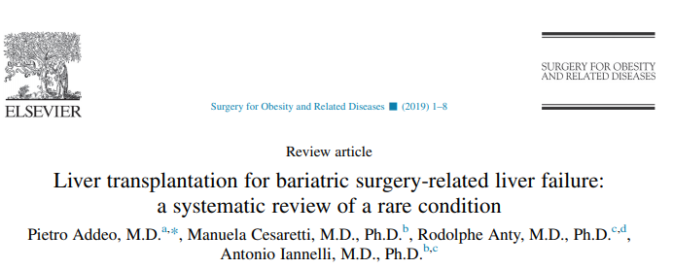
Mortalidad 4 %
Malnutrición (protéica)
Daño de la mucosa (barrera) intestinal, facilitando inflamación del Sistema porta por sobrecrecimiento bacteriano
Daño hepático previo (esteatosis hepática)
Mortalidad primeros 2 años después de procedimiento quirúrgico
Falla hepática
Notes:
The overall mortality rate for jejunoileal bypass was reported at approximately 4% in within the first two postoperative years and was usually related to liver failure. Jejunoileal bypass has long been abandoned, and the majority of patients with this procedure have undergone reversal or revision to another bariatric procedure. There are still a small number of patients with the original jejunoileal bypass remaining, who require close clinical observation and routine follow-up of liver function as well as liver biopsies because of the increased risk of hepatic failure and cirrhosis.

Slide 7
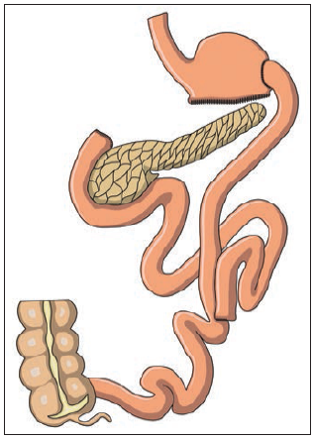
Derivación biliopancreática
250 cm
1979, Scopinaro et al.
“Pouch” gástrico horizontal (200-250 ml), anastomosis yeyuno (250 cm)
Pérdida del 70% de peso (90% de pacientes).
50-100 cm
Nguyen et al.. (2015). The ASMBS Textbook of Bariatric Surgery: Volume 1: Bariatric Surgery. 10.1007/978-1-4939-1206-3.
Notes:
The experience with jejunoileal bypass led investigators to consider pairing a malabsorptive and a restrictive process to obtain maximum sustainable weight loss. The restrictive process would result in food limitation and early satiety, whereas the malabsorptive process would result in decreased nutritional absorption (Table 1). The earliest combined bariatric procedure was the biliopancreatic diversion first reported in 1979 by Scopinaro et al. This was a modification of the jejunoileal bypass and consisted of a 200- to 250-mL horizontal gastric pouch associated with a distal gastrectomy and closure of the duodenal stump, as well as a gastroenterostomy with a 250-cm Roux limb. The biliopancreatic limb was anastomosed to the Roux limb 50 cm proximal to the ileocecal valve (Fig. 6). This procedure is currently more popular outside the United States and can result in 70% long-term weight loss in more than 90% of patients.

Slide 8
Disminución de “bypass enteritis” y falla hepática.
Menor incidencia de diarrea, nefrolitiasis, úlceras marginales, malnutrición protéica, DHE
→ Terapia nutricional de por vida (calcio, vitaminas)
→ S. Post gastrectomía (úlceras, S. Dumping
Notes:
Biliopancreatic diversion significantly eliminates bypass enteritis of jejunoileal bypass and the related hepatic failure. Also, the increased bowel length decreases the incidence of frequent diarrhea, renal calculi, marginal ulcers, protein malnutrition, and vitamin and electrolyte deficiencies. However, there are frequent voluminous and malodorous stools and flatus associated with this operation. Increased risk of deficiency of calcium and fat-soluble vitamins and protein requires lifelong replacement therapy. Patients can also suffer from postgastrectomy syndrome, which includes marginal ulcers and dumping.

Slide 9
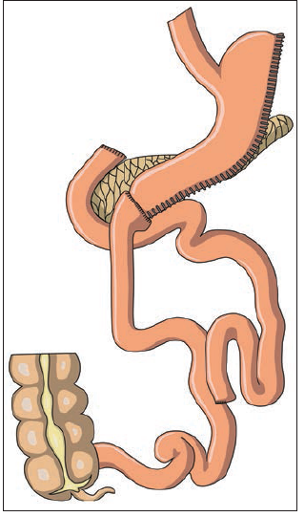
Derivación biliopancreática + Switch Duodenal
1993, Marceau (preservación de píloro)
Anastomosis duodeno (250 cm). Asa biliopancreática a 50-100 cm de válcula ileocecal
IMC >55, Cirugía de revision
Mayor pérdida de peso a largo plazo y menor re ganancia del mismo
Asa común corta: (malabsorción asa común) mayor pérdida primeros 2 años
Nguyen et al.. (2015). The ASMBS Textbook of Bariatric Surgery: Volume 1: Bariatric Surgery. 10.1007/978-1-4939-1206-3.
Notes:
The high incidence of postgastrectomy syndrome resulted in modification of biliopancreatic diversion with the addition of a pylorus sparing procedure first described by Marceau in 1993 [18]. In this procedure, the greater curvature of the stomach is resected, leaving a tubelike gastric remnant while preserving the pylorus. The enteric limb (250-cm Roux limb) is anastomosed to the postpyloric duodenum. A long duodenobiliopancreatic limb is anastomosed to the Roux limb 50 cm proximal to the ileocecal valve (Figs. 7 and 8).
Biliopancreatic diversion with duodenal switch is an effective surgery for weight loss, but because of its associated complications, it is reserved for superobese patients, especially those with a body mass index greater than 55. It can also be performed as a revision for other failed bariatric procedures [18]. Biliopancreatic diversion with duodenal switch allows patients to lose weight without significantly altering their eating habits, resulting in greater long-term weight loss and less weight regain [19]. Investigators have shown that a longer alimentary limb and biliary limb with a shorter common channel in superobese patients can result in greater weight loss over a 2-year postoperative period. This effect is due to decreased absorption of nutrients in the common channel, which receives food mixed with gastric, biliary, and pancreatic fluids
from both alimentary and biliary limbs

Slide 10
Deficiencia calcio, hierro, magnesio.
Fuga anastomosis, fistula GI, abscesos Obstrucción intestinal, hernia interna/ abdominal
2/3: “pouch gástrico” 1/3: asa biliopancreática
Mortalidad 1% (2.5% laparoscópica)
2000: primer procedimiento robótico DBP/SD
Nguyen et al.. (2015). The ASMBS Textbook of Bariatric Surgery: Volume 1: Bariatric Surgery. 10.1007/978-1-4939-1206-3.
Notes:
Although the incidence of postgastrectomy syndrome decreased with biliopancreatic diversion with duodenal switch, other associated complications are similar to those patients with biliopancreatic diversion and include calcium, iron, magnesium, vitamin, and protein deficiency, as well as malodorous stools and flatus [5]. The risk of anatomic complications related to the operative procedure is higher because of multiple anastomoses and includes bowel obstruction, ventral and internal hernia, anastomotic leak, fistulas, and abscess. Bowel obstruction is the most common complication, with two thirds of these cases involving the gastric pouch and one third of cases involving the distal anastomotic sites, most commonly the biliopancreatic limb. Biliopancreatic diversion with duodenal switch is performed via laparotomy as well as laparoscopically. The first robotically assisted biliopancreatic diversion with duodenal switch was performed in 2000 by a totally intracorporeal approach. The operative mortality for biliopancreatic diversion with duodenal switch is approximately 1%. This rate is slightly higher (2.5%) for the laparoscopically performed biliopancreatic diversion with duodenal switch. This mortality rate may decrease as the surgeon gains expertise with the technical aspects of this procedure and overcomes the associated learning curve

Slide 11
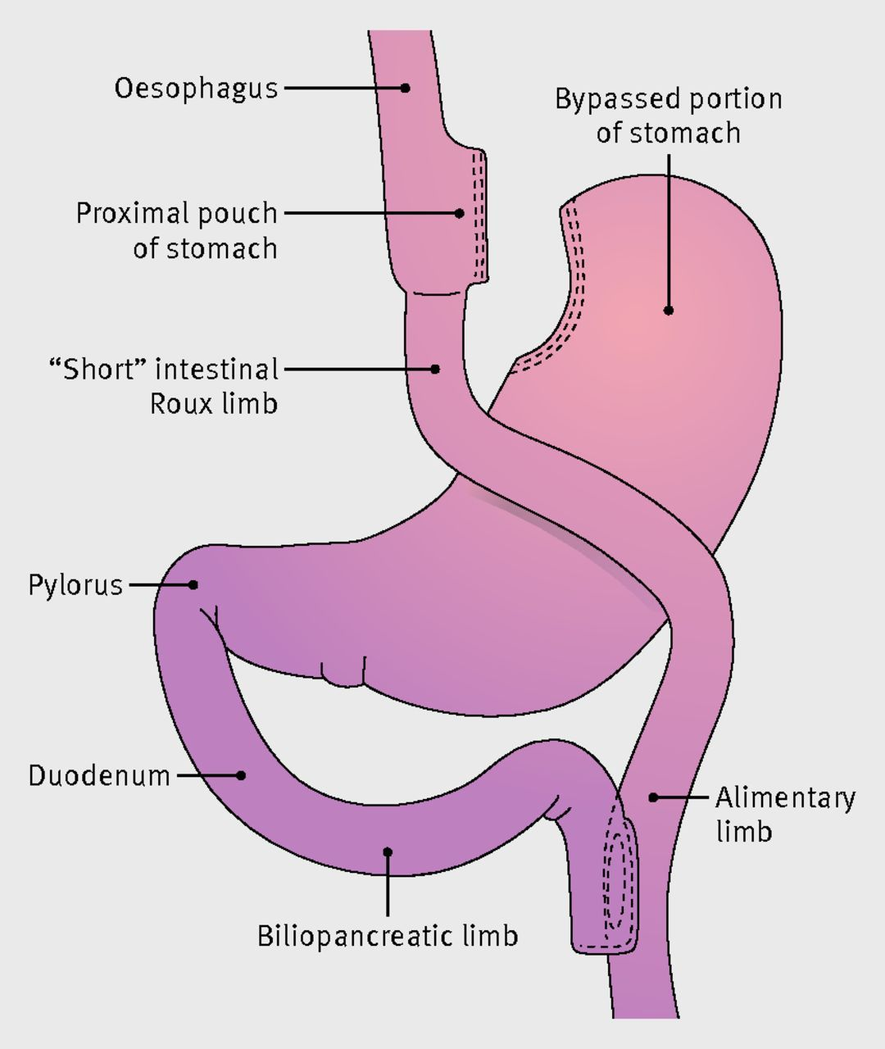
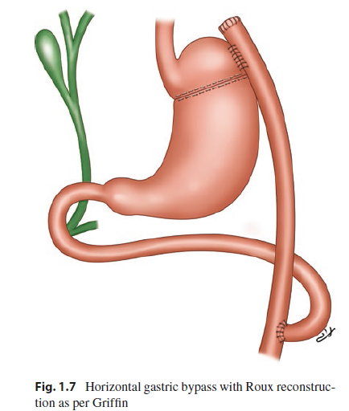
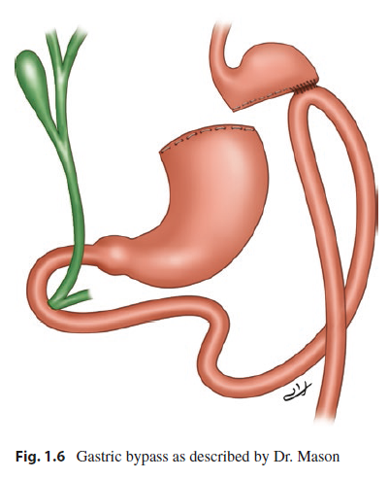
Bypass gástrico en “Y de Roux”
1967, Mason
“Pouch gástrico” + gastro yeyuno anastomosis “loop”
1977, Griffin
“Pouch” <50 ml, vertical
Anastomosis <1 cm
Y-de-Roux (prevención reflujo biliar)
45 cm lig. Treitz, asa 100-150 cm
Retrocólica
1892, Cesar Roux
Nguyen et al.. (2015). The ASMBS Textbook of Bariatric Surgery: Volume 1: Bariatric Surgery. 10.1007/978-1-4939-1206-3.

Slide 12
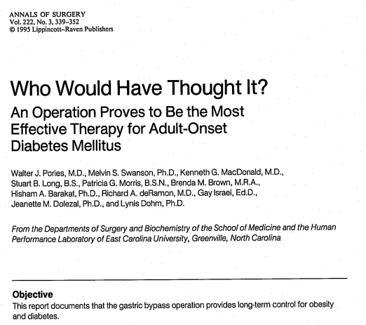
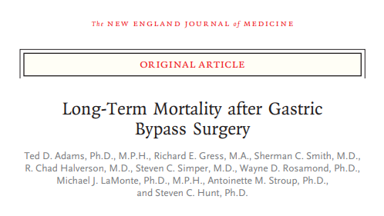
1995, Pories
600 pacientes, 14 años
Mortalidad 1.5 %
Morbilidad 8.5%
Pérdida de peso 45 k (mantenida)
Remisión de comorbilidades
2007, Hunt (Utah, EE.UU)
9949 pacientes, 7.1 años
Disminución de mortalidad un 40% (muertes asociadas a DM, complicaciones cardiovasculares y cancer)
cirugia abierta

Slide 13
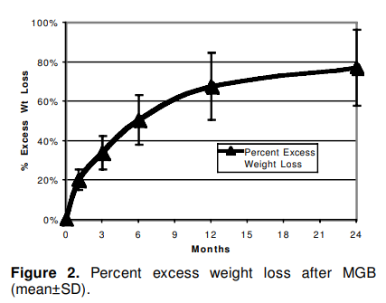
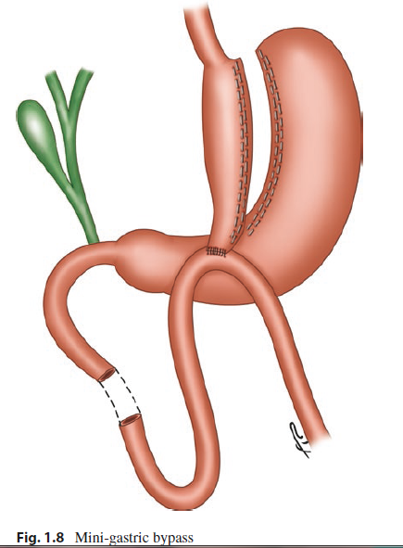
“Mini gastric bypass”
1997, Rutledge
Billroth II → Bypass una anastomosis.
Tiempo quirúrgico 37 min
Pérdida de exceso de peso 77% (2 años P.O.)
Fuga 1.6%
Asociado a malignidad
Nguyen et al.. (2015). The ASMBS Textbook of Bariatric Surgery: Volume 1: Bariatric Surgery. 10.1007/978-1-4939-1206-3.

Slide 14
Conclusión
Aunque no se realizen ciertos procedimientos, aún acuden a consulta pacientes con complicaciones de la cirugía previa ó con falla del tratamiento y re ganancia de peso.
Notes:
Surgical management of obesity has evolved over the past five decades and now is a popular treatment method for morbidly obese patients. Various restrictive and malabsorptive procedures, or a combination thereof, have been tried clinically. The majority of these techniques are no longer performed because of associated severe complications. However, there are still patients with these procedures who are either under clinical surveillance or are being evaluated for revision or conversion to other bariatric procedures (Table 2). Knowledge of the surgical anatomy, radiologic appearance, and the associated complications is essential to the radiologist evaluating these patients.

Slide 15
Moshiri, M. et al. (2013). Evolution of Bariatric Surgery: A Historical Perspective. American Journal of Roentgenology, 201(1), W40–W48. doi:10.2214/ajr.12.10131
Nguyen et al.. (2015). The ASMBS Textbook of Bariatric Surgery: Volume 1: Bariatric Surgery. 10.1007/978-1-4939-1206-3.
Lutfi, Rami & Palermo(2018). Global Bariatric Surgery The Art of Weight Loss Across the Borders: The Art of Weight Loss Across the Borders. 10.1007/978-3-319-93545-4.
KRAL, J. G. (1985). Morbid Obesity and Related Health Risks. Annals of Internal Medicine, 103(6_Part_2), 1043. doi:10.7326/0003-4819-103-6-1043
Kremen, A. J., Linner, J. H., & Nelson, C. H. (1954). AN EXPERIMENTAL EVALUATION OF THE NUTRITIONAL IMPORTANCE OF PROXIMAL AND DISTAL SMALL INTESTINE. Annals of Surgery, 140(3), 439. doi:10.1097/00000658-195409000-00018
Addeo, P., Cesaretti, M., Anty, R., & Iannelli, A. (2019). ]Liver transplantation for bariatric surgery-related liver failure: A systematic review of a rare condition. Surgery for Obesity and Related Diseases. doi:10.1016/j.soard.2019.06.002
Rutledge R. The mini-gastric bypass: experience with the first 1,274 cases. Obes Surg. 2001;11:276–80.

