Slide 1
Genética y obesidad

Slide 2
La identificación de un número significativo de genes relacionados con obesidad, no se ha traducido en un explicación de la genética subyacente a la obesidad.
Notes:
Actualmente hay una serie de teorías que explican La base genética de la obesidad, pero no existe consenso en el campo, probablemente como consecuencia de la interacciones genéticas complejas que afectan la susceptibilidad a obesidad. La identificación de un número significativo de genes en formas raras de obesidad no se ha traducido en un explicación de la genética subyacente a la obesidad común.

Slide 3
La obesidad es una condición compleja porque resulta de la interacción de múltiples genes con el medio ambiente.
Aproximadamente 50 - 70% de los cambios en el IMC son atribuibles a diferencias genéticas inherentes a cada persona.
En solo el 5% de los casos, la obesidad se debe a la existencia de cambios monogénicos.
Notes:
approximately 50---70% of changes in body mass index (BMI) are attributable to genetic differences inherent to each subject.11 Based on this, environmental interaction in
subjects with obesity susceptibility genes is currently considered to be the main cause of obesity.12 In only 5% of cases is obesity due to the existence of monogenic changes or to low incidence syndromes.13 Obesity is a complex condition because it results from the interaction of multiple genes with the environment.17 The obesity map thus suggests that all chromosomes, except for chromosome Y, have genes involved in obesity occurrence and development.19 There is now sufficiently solid scientific evidence, provided by 222 studies conducted on genes and obesity, for us to be able to say that there are 71 genes which are potential inducers of the occurrence of obesity.20 Of these, 15 genes are closely associated with body fat volume.21 It is therefore natural to think that there
is not a single type of obesity, but several types with similar phenotypes.22

Slide 4
>70 genes, posicionados en vía leptina/melanocortina en SNC; saciedad disminuida
Monogénica (un gen responsable)
Obesidad sindrómica (Obesidad + síntomas específicos)
Obesidad poligénica* (95%)
*Obesidad común
Anormalidades cromosómicas; hiperfagia
Notes:
Obesity is commonly classified into subgroups depending on suspected etiology: monogenic obesity (extremely severe obesity in the absence of developmental delays), syndromic obesity (clinically obese subjects additionally distinguished by mental retardation, dysmorphic features, and organ-specific developmental abnormalities), and polygenic or common obesity, which affects the general population (but may have associated health risks, such as increased risk of CVD).
The first single gene defect causing monogenic obesity was described in 1997, and to date, there are about 20 single gene disruptions that result in an autosomal form of
obesity [1]. Interestingly, all these mutations position the leptin/melanocortin pathway in the central nervous system (CNS) as critical in the regulation of whole-body energy
homeostasis [13], and obesity in these cases appears to be the result of increased appetite and diminished satiety.
Syndromic obesity arises from discrete genetic defects or chromosomal abnormalities at several genes, and can be autosomal or X-linked. One of the most well-known forms of syndromic obesity is Prader-Willi syndrome (PWS), which is caused by a chromosomal abnormality of an imprinted region on chromosome 15q11-q12. PWS is
characterized by early-onset obesity resulting from hyperphagia caused by CNS dysfunction [14]. Because both monogenic and syndromic forms of obesity tend to have
high penetrance, detection of causal genetic variants has been quite fruitful

Slide 5
Genes que codifican péptidos destinado a transmitir señales de apetito y saciedad
Genes involucrados en el crecimiento y diferenciación de adipocitos
Genes involucrados en el control del gasto energético
Notes:
Genes involved in the etiology of obesity include genes encoding peptides targeted to transmit hunger and satiety signals, genes involved in adipocyte growth and differentiation, and genes involved in energy expenditure control.
Los genes involucrados en la etiología de la obesidad incluyen genes que codifican péptidos destinados a transmitir señales de hambre y saciedad, genes involucrados en el crecimiento y diferenciación de adipocitos, y genes involucrados en el control del gasto energético.

Slide 6
Todos los cromosomas tienen genes involucrados en la aparición y desarrollo de la obesidad
71 genes son inductores potenciales de la aparición de obesidad
15 genes están estrechamente asociados con el volumen de grasa corporal
Varios tipos, fenotipos similares
Notes:
The obesity map thus suggests that all chromosomes, except for chromosome Y, have genes involved in obesity occurrence and development.19 There is now sufficiently solid scientific evidence, provided by 222 studies conducted on genes and obesity, for us to be able to say that there are 71 genes which are potential inducers of the occurrence of obesity.20 Of these, 15 genes are closely associated with body fat volume.21 It is therefore natural to think that there
is not a single type of obesity, but several types with similar phenotypes.22

Slide 7
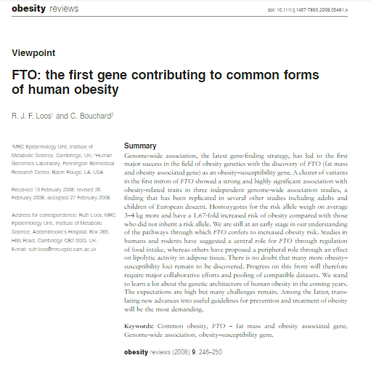
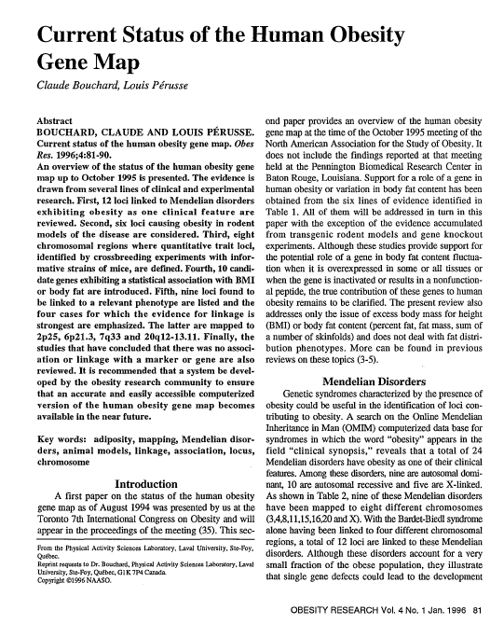
1996 “Human Obesity Gene Map”
GWAS (Genome-wide association studies)
FTO, 2007
> 70 genes relacionados
Afectando SNC o via periférica (tejido adiposo)
Bouchard,C. Current Status of the Human Obesity Gene Map. OBESITY RESEARCH Vol. 4 No.1 Jan. 1996
Notes:
The first substantial advances in the discovery of obesity susceptibility loci were made in 2007 [29••, 30]. This was possible through technical and analytical developments
allowing for genome-wide association studies (GWAS). GWAS capitalize on the realization that common genetic markers can be inherited together as “blocks” due to
linkage disequilibrium. The initial success of finding the first robustly associated obesity susceptibility locus, FTO (fat mass and obesity associated), in 2007, [29••, 30, 35••–38– 40••] revealed the small effects sizes of obesity genes and propagated the notion that increasing power and sample size of studies was necessary to identify further susceptibility loci. As a result, even larger and better powered studies have followed, as have multicenter collaborative studies and meta-analyses (Table 1), which have accumulated more than 20 replicated obesity loci.
Overall, many genes within the associated regions have been reported to fall within two broad categories: genes affecting CNS function and those that are suggested to operate peripherally, often through adipose tissue
El éxito inicial de encontrar el primer locus de susceptibilidad a la obesidad sólidamente asociado, FTO (masa grasa y obesidad asociada), en 2007, reveló los pequeños tamaños de efectos de los genes de obesidad y propagó la noción de que era necesario aumentar el poder y el tamaño de la muestra de los estudios para identificar más susceptibilidad loci. Como resultado, se han seguido estudios aún más grandes y mejor potenciados, al igual que estudios colaborativos multicéntricos y metaanálisis, que han acumulado más de 20 loci de obesidad replicados.

Slide 8
SNC → Hipotálamo
(Obesidad monogénica)
FTO: dimetilación acidos nucléicos (Balance Energético y Comportamiento alimenticio)
MC4R, 6% desarrollo temprano Obesidad
BDNF (brain-derived neutrotophic factor) y NRXN3 (neurexin 3), abuso de sustancias y comportamiento de recompensa. Dopamina
NEGR1 (neural growth regulator) promotor de crecimiento axonal
TMEM18 (transmembrane protein 18) realza la capacidad de migración celular
KCTD15 (potassium channel tetramerization domain-containing)
GNPDA (glucosamine -6-phosphate deaminase-2)
MTCH2 (mithocondrial carrier homolog 2)
SDCCAG8 (serologically defined colon cancer antigen)
FAIM2 (fast apoptotic inhibitory molecule)
ETV5 (ets variant 5)
NCPR1 (endosomal/lysosomal Niemann-Pick C1 gene)
PRL (prolactin)
Notes:
Several of the genes located within or near the associated regions are highly expressed in the CNS, particularly in the hypothalamus [36••], and appear to be involved in appetite, satiety, energy expenditure, and behavior. This suggests that similar mechanisms would be affected in common forms as in monogenic forms of obesity. FTO has a potential role in nucleic acid demethylation and is highly expressed in parts of the brain that govern energy balance [41••] and feeding behavior [42, 43]. MC4R (melanocortin 4 receptor) is reported to be responsible for up to 6% of early-onset or severe adult obesity cases [44]. In addition, disrupted MC4R in mice causes hyperphagia, hyperinsulinemia, and hyperglycemia [45]. SH2B1 (Src-homology-2 [SH2] domain-containing putative adaptor protein-1) is associated with increased serum leptin [46]. BDNF (brain-derived neurotrophic factor) and NRXN3 (neurexin 3 ) are linked to substance abuse and reward behavior, probably interfering with dopamine neurotransmission in pathways involved in reward effects, motivation, and decision making [47, 48]. NEGR1 (neuronal growth regulator 1) is a growth promoter that participates in the regulation of axon outgrowth in the developing brain [37••]. TMEM18 (transmembrane protein 18) enhances the migration capacity of cells [49] and is
highly expressed in the hypothalamus. Another eight genes associated with obesity are highly expressed in the hypothalamus [36••]: KCTD15 (potassium
channel tetramerization domain-containing 15), GNPDA (glucosamine-6-phosphate deaminase-2) MTCH2 (mitochondrial
carrier homolog 2), SDCCAG8 (serologically defined colon cancer antigen 8), FAIM2 (Fas apoptotic inhibitory molecule 2), ETV5 (ets variant 5), NCP1 (endosomal/
lysosomal Niemann-Pick C1 gene), and PRL (prolactin) are thought to be involved in obesity susceptibility via CNS-mediated effects.

Slide 9
Acción genética periférica
Distribución de grasa/ Obesidad central
TFAP2B (transcription factor activating enhancer- binding protein 2β), tejido adiposo, acumulación lípidos, expresión adinopectina
NCR3 (natural cytotoxicity triggering receptor)
PTER (phosphotriesterase related) bajo grado de inflamación de tejido adipose
C-MAF , adipogénesis
LYPLAL1 (lysophospholipase-lile-1) * tejido celular subcutáneo
Notes:
Other associations observed in GWAS, which affect susceptibility to obesity, may operate peripherally (those primarily associated with fat-distribution and/or central
obesity). Among these, we include the following: TFAP2B (transcription factor activating enhancer-binding protein 2 β) preferentially expressed in adipose tissue, which is
involved in glucose transport, lipid accumulation, and adiponectin expression [17••]; NCR3 (natural cytotoxicity triggering receptor 3) and PTER (phosphotriesterase related),
which might mediate their effect through the hypothesized low-grade inflammation of adipose tissue [50]; and lastly c-MAF, a transcription factor involved in adipogenesis
[38••]. In addition, the interesting female-only association to LYPLAL1 (lysophospholipase-like-1) is caused by a lipase with increased expression in subcutaneous adipose tissue [17••]. This finding is of particular interest as it supports previous hypotheses that there are sex-specific genes contributing to variation of obesity-related traits and that genes account for more variance of fat distribution in women than in men. It is also worth noting that although involved in the production of leptin and thus proposed to operate through CNS, SHB2B1 also has an effect on total fat [52] and may have a dual role in obesity susceptibility.

Slide 10
Mutaciones en genes implicados en codificación y síntesis de proteínas involucradas en la regulación del apetito y saciedad
Notes:
It is currently also accepted that mutations in genes implicated in the coding and synthesis of proteins involved in appetite regulation are responsible for pathological
changes associated with the development of obesity.23 Gene mutations which, in turn, have been found to cause monogenic obesity include mutation in leptin gene, leptin receptor (LEPR), carboxypeptidase E, orexigenic agouti protein, the prohormone convertase 1 (involved in the processing of insulin and proopiomelanocortin, POMC), and POMC 6---8 itself.24 Forms of obesity resulting from mutations in the gene encoding for melanocortin receptors 3 and 4 (MC3R and MCR4) have also been reported.
Actualmente también se acepta que las mutaciones en genes implicados en la codificación y síntesis de proteínas involucradas en la regulación del apetito son responsables de cambios asociados con el desarrollo de la obesidad23.
Many of the genes identified for monogenic obesity disrupt the regulatory system of appetite and weight described above. Most mutations require 2 dysfunctional copies of the gene in homozygous or compound heterozygous form to manifest the phenotype. A summary of the individual causes of monogenic obesity can be found in Table 1.

Slide 11
La deficiencia de leptina fue la primer causa de obesidad mogénica demostrada en un paciente humano.
Vía leptina/melanocortinas.
Receptor LEPR, POMC, PCSK1, MC4R
SIM1, BDNF 36, NTRK2
Balance energético
Hiperfagia
Notes:
After the identification of the leptin gene in mice and then in humans28, leptin deficiency was the first cause of monogenic obesity to be demonstrated in a human patient29 la deficiencia de leptina fue la primera causa de monogénica obesidad que se demostrará en un paciente humano.
examination of cases of severe early-onset obesity have continued to provide information on obesity genes, leading to the identification of variants in additional genes in the leptin–melanocortin pathway, including leptin receptor (LEPR)30, proopiomelanocortin (POMC)31, pro-hormone convertase subtilisin/kexin type 1 (PCSK1)32 and MC4R33,34. Mutations in three genes also involved in neural development have now been identified as the underlying cause of rare monogenic obesity: single-minded homologue 1 (SIM1)35, BDNF 36 and neurotrophic tyrosine kinase receptor type 2 (NTRK2; also known as tropomyosin-related kinase B, TRKB)37. These are all involved in the functioning of the hypothalamus (the main control region for energy balance) and it is clear that the main consequence of inactivation of these genes is hyperphagia resulting in distortion of the bodily energy balance towards energy intake.

Slide 12
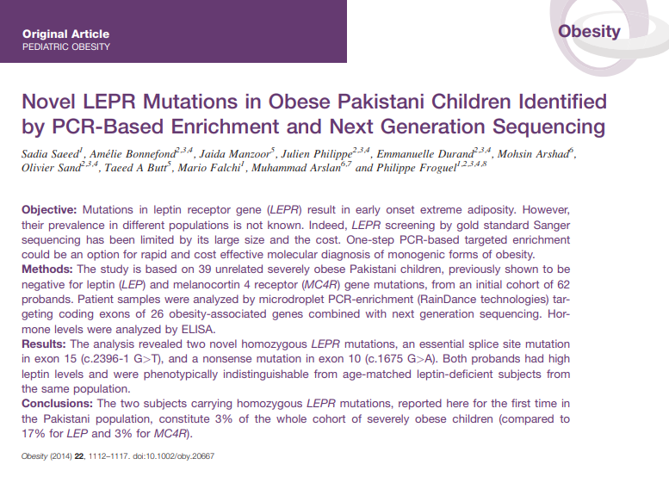
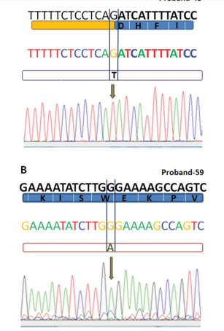
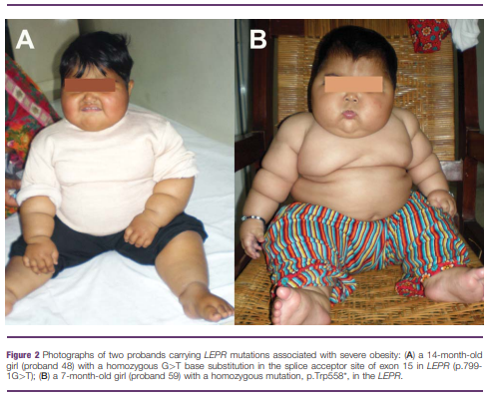
Deficiencia de leptina
Gen LEP, cromosoma 7q31.3
Herencia recesiva
Hasta 10 mutaciones de leptina
Ganancia de peso post natal, hiperfagia
Inmunidad Cel T defectuosa
Hipogonadismo hipogonadotrópico
Obesidad y efectos secundarios
FDA→ Metrelpetina
Saeed, S., Bonnefond, A., Manzoor, J., Philippe, J., Durand, E., Arshad, M., Sand, O., Butt, T.A., Falchi, M., Arslan, M. and Froguel, P. (2014), Novel LEPR mutations in obese Pakistani children identified by PCR‐based enrichment and next generation sequencing. Obesity, 22: 1112-1117. doi:10.1002/oby.20667
Notes:
Congenital leptin deficiency follows a recessive mode of inheritance, and was first identified in two extremely obese first-degree cousins from a Pakistani family caused by a frameshift mutation (c.398delG).16 Since then ten other mutations in the leptin gene have been described.17–27 The cardinal phenotypic manifestations are rapid weight gain after normal birth weight resulting in severe early onset obesity caused by intense hyperphagia.28 In addition, some of these children have severe and possibly lethal bacterial infections due to defective T-cell immunity29 and hypogonadotropic hypogonadism.16 The children often have secondary adverse effects of severe obesity such as hyperinsulinemia, severe liver steatosis and dyslipidemia. The protein change can vary from early termination of the protein resulting in low to undetectable levels of the leptin hormone to the loss of biological activity with normal levels
Although relatively rare, and mostly seen in consanguineous families, congenital leptin deficiency presents a unique opportunity for treatment with recombinant leptin that improves the adiposity, and restores gonadal and immune function.27,30 The Food and Drug Administration has approved the use of Myalept (metreleptin) for the treatment of congenital leptin deficiency and generalized lipodystrophy
LEP gene located on chromosome 7q31.3

Slide 13
Mutación Receptor de Leptina (LEPR)
2-3%
Deficiencia hormona de crecimiento y función tiroidea
≠ tratamiento
Notes:
Leptin Receptor (LEPR) mutations
Mutations in LEPR can cause phenotype similar to that of leptin deficiency, without low serum levels. 32 The use of next generation sequencing has facilitated the identification of LEPR mutations, with estimates of 2–3% in certain populations.33–36 Co-existing growth hormone and thyroid function deficiency has also been described.37,38 Unlike leptin deficiency, individuals with homozygous LEPR mutations are not amenable to treatment with recombinant leptin.

Slide 14
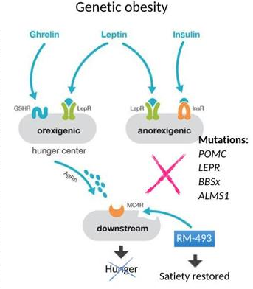
Mutación POMC
Ausencia ACTH, α-MSH and β-endorphins.
<10 personas descritas en el mundo
Con o sin insuficiencia adrenal
Tx: Setmelanotida
Notes:
Deficiency in the POMC protein results in the absence of cleavage products of ACTH, α-MSH and β-endorphins.39 Due to the dual role of α-MSH in appetite regulation and pigmentation, the classic presentation is that of red hair and severe obesity. Adrenal insufficiency results from deficiency of ACTH. Early recognition of adrenal insufficiency and rapid glucocorticoid replacement therapy is important for treatment. Fewer than 10 patients have been described around the world. A few studies have also noted the presence of heterozygous POMC mutations in individuals with obesity, without adrenal insufficiency and other classic manifestations.40,41 A new melanocortin-4 receptor agonist, Setmelanotide, has been shown to have therapeutic potential for POMC deficiency.4

Slide 15
Deficiencia MC4R
Regulación del apetito
Mutaciones dominantes y recesivas
0.5-6% obesidad de inicio temprano*
Hiperfagia, talla alta, hipertensión arterial, edad ósea avanzada
Tx: Setmelanotida
Notes:
The melanocortin receptor (MC4R) is a G-protein coupled, seven transmembrane receptor which is highly expressed in the hypothalamus, the region of the brain involved in appetite regulation.43 Rodent studies indicate that the binding of MC4R with α-MSH, its high affinity ligand produced from POMC, inhibits feeding.44 Subsequently, mutations in MC4R, both in dominant and recessive form, have been demonstrated as the most common cause of inherited early-onset obesity with prevalence between 0.5–6% in different populations. 45–49 Affected children demonstrate hyperphagia with food-seeking behavior in early childhood, are taller than their peers, may have higher blood pressure and advanced bone age, but are otherwise not dysmorphic.45 Therapeutic perturbation of the MC4R to improve the satiety circuits is an active area of investigation, but not available for clinical use yet.

Slide 16
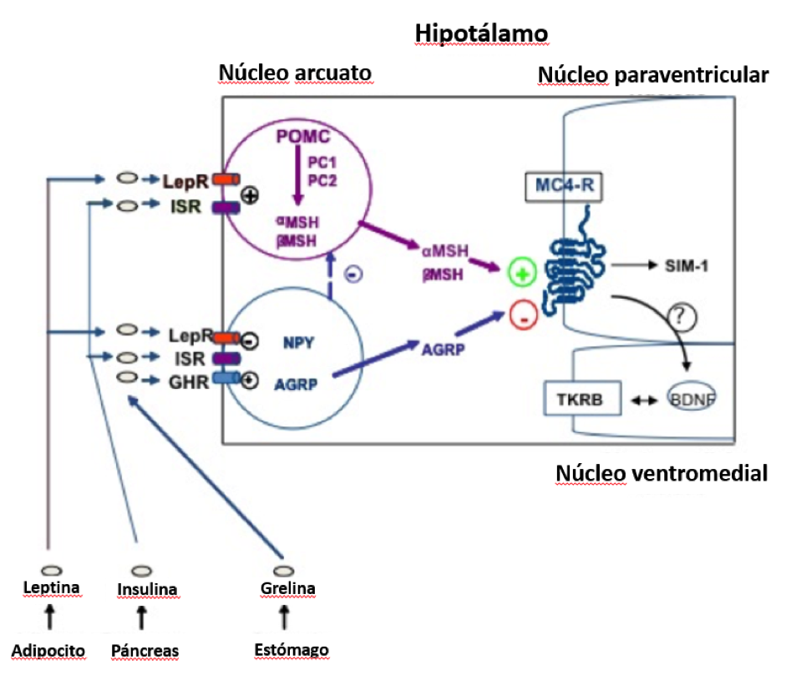
Deficiencia de Pro convertasa (PC1/2)
Proteasas
Ausencia de PC1/PC2, insuficiencia andrenal, tiroidea, gonadrotopica, somatotropina: hipoglicemia reactiva, diabetes insipida
Obesidad inicio temprano
Notes:
Proprotein convertase-1/2 are neuroendocrine convertase endoproteases that process large precursor proteins into mature bioactive products. 53 Absence of activity of PC1/PC2 results in adrenal, gonadotropic, somatotropic, and thyrotropic insufficiency, along with postprandial hypoglycemic malaise caused by lack of insulin processing, severe malabsorptive neonatal diarrhea and central diabetes insipidus, in addition to severe early onset obesity.54–58 These enzymes are an attractive target for molecular intervention, although no therapies are available at the moment.

Slide 17
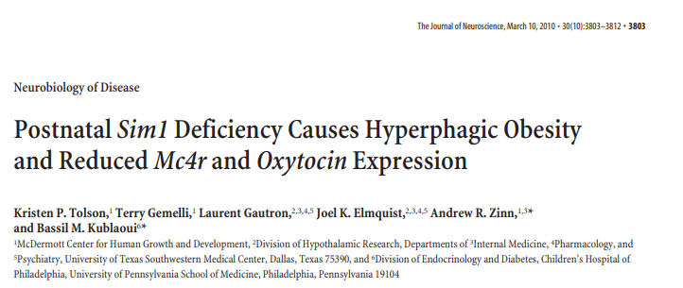
Deficiencia SIM1
Cromosoma 6q16 , NPV
Deleción o mutaciones, hiperfagia, impulsos alimenticios
Disminución en la concentración, memoria, labilidad emocional, espectro autista
Notes:
Single-minded homologue of drosophila (SIM1) is a transcription factor located on chromosome 6q16 and is strongly expressed in the paraventricular nucleus of the hypothalamus, a critical regulator of appetite. 59 Deletions or heterozygous mutations in SIM1 have been associated with hyperphagia, food impulsivity, and neurobehavioral features such as impaired concentration, memory deficit, emotional lability or autism spectrum disorder.

Slide 18
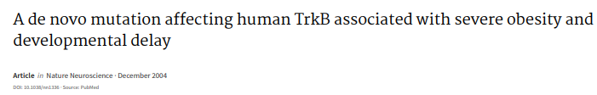
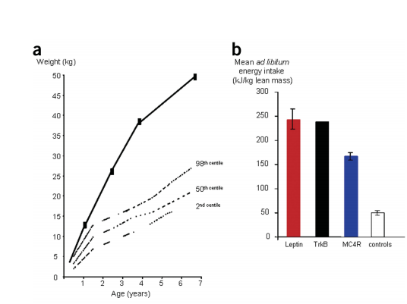
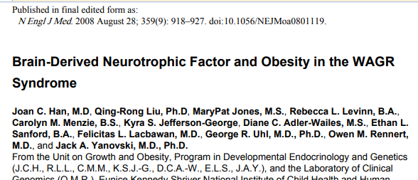
Mutación NTRK2/BDNF
NTRK2→TrkB→BDNF
Neurotrofinas
Regulación en la ingesta de alimento, peso corporal
Masculinos, caucásico con obesidad
Deleción BDNF, síndrome WAGR (tumor Wilms, aniridia, anormalidades genitourinarias, retraso mental) con Obesidad de inicio temprano
Notes:
These neurotrophins are a family of growth factors known to be involved in the development, maintenance and function of peripheral and central neurons. The neurotrophin receptor TrkB and its natural ligand, brain derived neurotrophic factor (BDNF), have been implicated in the regulation of food intake and body weight in animal studies. Heterozygous loss of function mutation in NTRK2, that codes for TrkB was demonstrated in a Caucasian male with severe early onset obesity with no other syndromic features.62 Individuals with deletions in BDNF gene as part of the WAGR syndrome (Wilms’ tumor, aniridia, genitourinary anomalies and mental retardatio) have early onset obesity63.

Slide 19
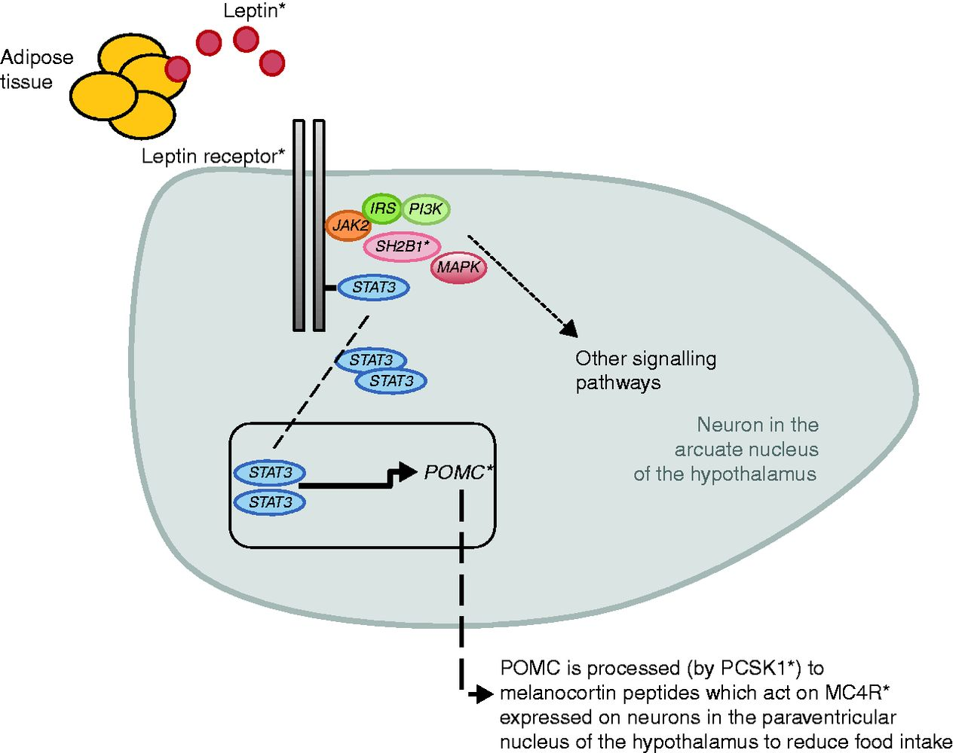
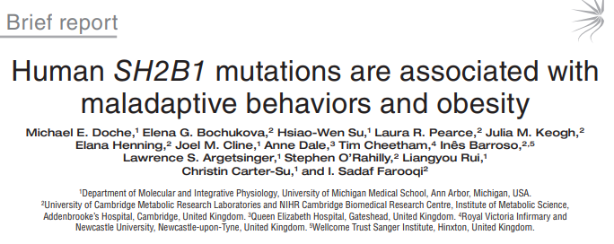
Mutación SH2B1
Regulador positivo de la sensibilidad a la leptina
Niños, con aparición temprana de obesidad severa
Hiperfagia, hiperinsulinemia, talla baja, retraso en lenguaje, comportamiento agresivo.
Notes:
Src homology 2 B adapter protein (SH2B1) is a positive regulator of leptin sensitivity.64 Following the identification of its role in animal models, mutations in SH2B1 were noted in 5 children of mixed European descent with severe early onset obesity inherited from their overweight/obese parents.65 The mutation carriers were noted to be hyperphagic, had reduced final adult height, hyperinsulinemia without diabetes, delayed speech and language, and aggressive behavior. Subsequent studies of additional variants in the gene have shown milder phenotypes indicating a variability in the presentation.

Slide 20
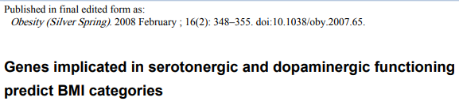
Gen ADIPOQ
CNR1 (cannabinoide)
DRD2 (dopamina) receptores
HTR2C (serotonina)
SLC6A4 (serotonina) niveles
MAOA (monoaminooxidasa)
Notes:
The common SnP –11391G>A, which is located in the proximal promoter of the adiponectin gene (ADIPOQ) and increases ADIPOQ expression (and adiponectin levels), has been associated with severe childhood and adult obesity in French Caucasians58 and with adult obesity in other populations59–61.
The discovery of associations between obesity and genes encoding cannabinoid receptor 1 (CNR1), dopamine receptor 2 (DRD2) and serotonin receptor 2C (HTR2C underscores the
importance of neural signalling and the pathogenesis of obesity. Genes involved in regulating serotonin function (SLC6A4) and monoamine levels (MAOA) have also been shown to be predictive of BMI

Slide 21
Notes:
Many genes underlying rare forms of monogenic obesity have been investigated for possible roles in common obesity, as well as others with more recently identified functional
roles. TABLe 1 lists candidate genes reported in the period
since our last Review in 2005 (

Slide 22
Fto
Fat mass and obesity – associated gene
2-oxoglutarato desmetilasa, Núcleo Arcuato
~1% del total IMC por herencia
Expresión SNC (balance energético)
Apetito = hiperfagia, disminución en la saciedad
Actividad lipolítica disminuida
Afectado por Actividad física
Notes:
FTO codifica un ácido nucleico dependiente de 2-oxoglutarato desmetilasa que se expresa ubicuamente pero la mayoría altamente expresado en núcleos hipotalámicos que gobiernan la energía equilibrio.24 variation in FTO was estimated to account for only ~1% of the total heritability of BMI.
FTO is widely expressed in the brain, with evidence from animal studies indicating a particularly high level of expression in the hypothalamic nuclei, which are involved
in regulating energy balance78. Both human and animal studies indicate that the gene may have a role in the regulation of appetite, with the risk allele associated with modestly increased food intake79,80 and decreased satiety81 in humans. The risk allele is also associated with decreased lipolytic activity in adipocytes, indicating a possible role in fat cell lipolysis82. Physical activity has been reported to modify the effects of the FTO risk allele, as it seems to have a stronger effect in people who are less active83.

Slide 23
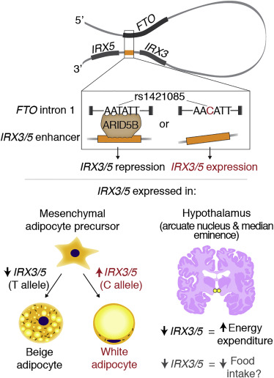
Alelo en FTO rs1421085 ≠ ARID5
expresión IRX3, IRX5
Almacenamiento de energía
Notes:
Studies in mesenchymal adipocyte precursors suggested that the risk allele at the FTO SNP rs1421085 disrupts a binding site for the ARID5 repressor, leading to increased expression of IRX3 and IRX5, which shifts the fate of these cells from energyburning beige adipocytes to energy-storing white adipocytes.
Los estudios en precursores de adipocitos mesenquimales sugirieron que el alelo de riesgo en el FTO SNP rs1421085 interrumpe un sitio de unión para el represor ARID5, lo que lleva a una mayor expresión de IRX3 e IRX5, lo que cambia el destino de estas células de adipocitos beige que consumen energía a adipocitos blancos que almacenan energía

Slide 24
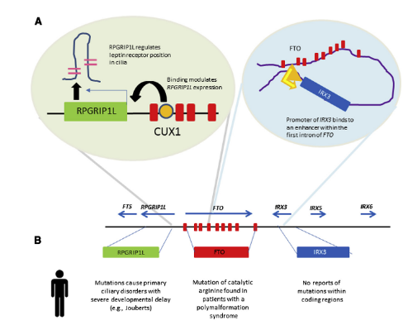
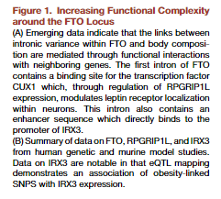
Efecto de FTO sobre IRX3 en SNC.
Alelo rs8050136 interrumpe la union del factor de transcripción P110 (ISOFORMA cux1)
Disminución de la expresión y consecuente reducción de la señalización de leptina
Notes:
Other studies suggested that the obesogenic effects of FTO SNPs on IRX3 operate in the brain29 or the pancreas.31 Studies in neural cells found that the risk
allele at the FTO SNP rs8050136 disrupts binding of the transcriptional activator P110 (an isoform of CUX1),resulting in decreased expression of FTO and RPGRIP1L
and consequent reduced leptin signalling.
Otros estudios sugirieron que los efectos obesogénicos de los SNP de FTO en IRX3 operan en el cerebro29 o el páncreas.31 Los estudios en células neurales encontraron que el riesgo alelo en el FTO SNP rs8050136 interrumpe la unión del activador transcripcional P110 (una isoforma de CUX1), lo que resulta en una disminución de la expresión de FTO y RPGRIP1L y consecuente reducción de la señalización de leptina.

Slide 25
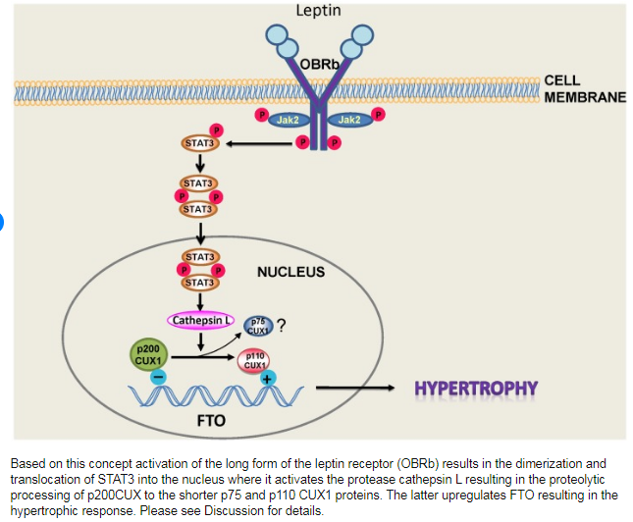
Induce aumento de peso progresivo en personas en los que se sobre expresa.
Wardle y col. mostraron una estrecha relación entre la sensación de saciedad reportada por personas con obesidad y el grado de expresión del gen.
Hiperfagia
Walley, A. The genetic contribution to non-syndromatic guman obesity. Nature Reviews Genetics (2009) 10:431–442
Notes:
Another gene widely studied because of its potential implication in the development of obesity at early ages is the FTO gene.26,27 This gene is considered to induce progressive weight gain in subjects in whom it is overexpressed.28
Its expression is usually greater in the hypothalamic areas involved in the feeding process.29 Thus, expression of this gene has been shown to be modified under conditions of acute food deprivation. Wardle et al. showed a close relationship between the sensation of satiety reported by obese subjects and the degree of expression of the gene.30 In this regard, patients carrying two risk alleles had a lower satiety response (Fig. 1).
Otro gen ampliamente estudiado debido a su potencial implicación en el desarrollo de la obesidad a edades tempranas es el gen FTO26,27. Se considera que este gen induce un aumento de peso progresivo en sujetos en los que se sobreexpresa.28 Su expresión suele ser mayor en las áreas hipotalámicas involucradas en el proceso de alimentación. Wardle y col. mostraron una estrecha relación entre la sensación de saciedad reportada por los sujetos obesos y el grado de expresión del gen.30 En este sentido, los pacientes con dos alelos de riesgo tuvieron una respuesta de saciedad menor.

Slide 26
Los esfuerzos para desarrollar tratamientos para la obesidad pueden requerir la focalización de IRX3, IRX5 o RPGRIP1L, o una combinación de estos
Queda por establecer si los efectos en el cerebro, el tejido adiposo y el páncreas contribuyen a la obesidad ó si un efecto en un tejido en particular es el principal.
.
Notes:
The effects of the FTO locus on distant genes might therefore be tissue-specific and vary by the developmental stage of the tissue. Whether effects in the brain, adipose tissue, and pancreas all contribute to obesity or whether an effect in a particular tissue is the primary effect remains to be established. Future efforts to develop treatments (or prevention strategies) for obesity might require targeting of IRX3, IRX5, or RPGRIP1L, or a combination of these.
Studies of other loci for obesity have not yet reached the level of molecular resolution achieved for FTO,34 but this knowledge will be realised in time. A deep understanding
of how a locus affects phenotype is essential before genetic findings can be used to improve human health.
For loci that encompass multiple genes, bioinformatics tools are emerging to help select the most promising SNPs and genes for initial functional interrogation

Slide 27
Obesidad sindrómica
Mutaciones en genes humanos responsables de la aparición de efectos pleiotrópicos asociados con obesidad
Fenotipo + obesidad severa de inicio temprano
>100 síndromes. 15% más de un nombre.
Frecuentemente: retraso cognitivo, facies dismórficas, anromalidades específicas
Sx. Bardet-Biedl, Sx Prader Willi
Notes:
On the other hand, mutations in some human genes responsible for the occurrence of pleiotropic effects associated with morbid obesity conditions such as clinical
manifestation have been known since the 1980s.31
The syndromic forms of obesity are often associated with phenotypes in addition to the early-onset severe obesity. This may be caused by change in a single gene or a larger chromosomal region encompassing several genes. Obesity is a feature of almost 100 syndromes; a little over half are not yet named, and 13.9% have more than one name.72 The co-presenting phenotypes often include intellectual disability, dysmorphic facies, or organ-system specific abnormalities. The most frequent forms of syndromic obesity are Bardet Biedl and Prader Willi syndrome.

Slide 28
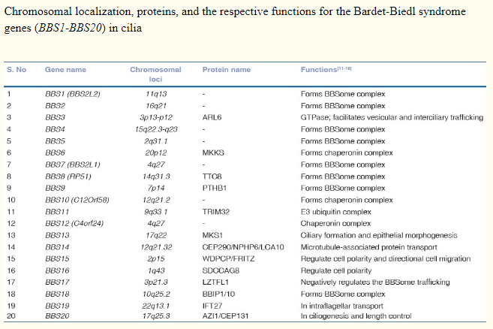
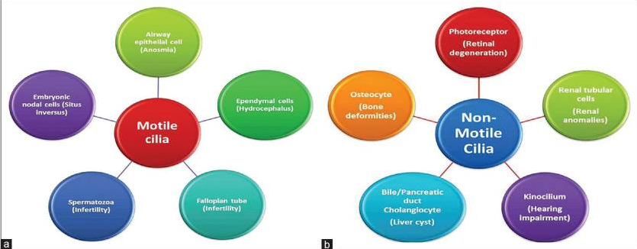
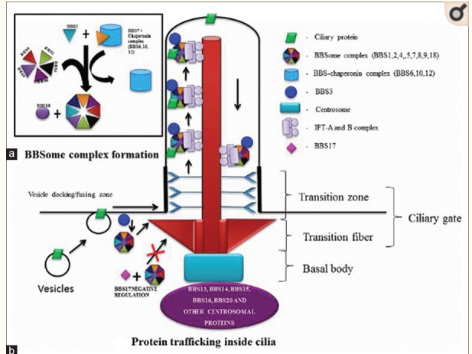
Síndrome Bardet-Bield
Autosómico recesivo
20 genes.
BBS6,
BBS10 30%
BBS12
Ciliopatía , desorden multisistémico
Obesidad, ceguera, retraso mental
hipogonadismo, polidactilia, insuficiencia renal, diabetes mellitus, hipercolesterolemia, fibrosis hepática, anosmia.
Priya S, Nampoothiri S, Sen P, Sripriya S. Bardet-Biedl syndrome: Genetics, molecular pathophysiology, and disease management. Indian J Ophthalmol. 2016;64(9):620–627. doi:10.4103/0301-4738.194328
Vidhu V. Thaker. Genetis and Epignetic Causes of Obesity. Adolesc Med State Art Rev. 2017 ; 28(2): 379–405.
Notes:
Finally, the Bardet-Bield syndrome, transmitted as an autosomal recessive disorder, has four known different variants depending on the affected genes. Mutated genes
include BBS1, located in chromosome 11, BBS2 located in chromosome 16, BBS3 located in chromosome 3, and BBS4 located in chromosome 15.37 This unique chromosome distribution of the involved genes accounts for the phenotypic variability of the syndrome. Clinically, pediatric patients will experience retinitis pigmentosa, mental retardation, hypogonadism, and some finger abnormalities reported by Mykytyn et al.38 Interactions between many of these genes involved and of these genes with the environment may lead to a phenotypic expression of obesity.

Slide 29
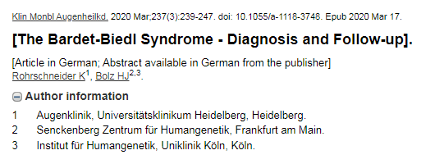
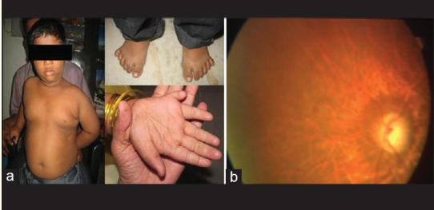
Polidactilia 63-80%
Distrofia de conos y bastones (retinosis pigmentaria); 90-100%
La obesidad está presente en la gran mayoría (72–86%)
Hiperfagia, Aumento gradual
IMC >30, 50%
Priya S, Nampoothiri S, Sen P, Sripriya S. Bardet-Biedl syndrome: Genetics, molecular pathophysiology, and disease management. Indian J Ophthalmol. 2016;64(9):620–627. doi:10.4103/0301-4738.194328
Notes:
Obesity is present in the vast majority (72–86%) of the individuals, although the birth weight may be normal. There is a high prevalence of Type 2 diabetes, hypogonadism, cognitive deficit, labile behavior, speech deficit, renal and cardiac anomalies.75 The biological defect for the syndrome is an abnormality in immotile cilia that primarily function as the sensory organelle regulating signal transduction pathways. The functional unit of the immotile cilia, or the BBSome, comprises of the cilium, the basal body, the chaperonin complex and other membrane proteins that maintain the function of the cilium. At the time of this writing, mutations in 16 different genes that alter the function of the BBSome at various levels have been identified (BBS1–BBS16). A comprehensive review of BBS can be found at GeneReviews

Slide 30
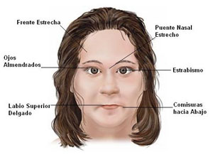
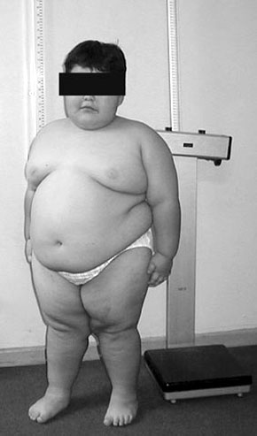
Síndrome Prader – Willy
1: 15 000
Autosómico Dominante
Cromosoma 15q11-13 (PWCR)
MKRN3, MAGEL2, NDN, NPAP1, SNURF-SNRPN
Facies características.
Diabetes mellitus, hipotonía, retraso mental, hipogonadismo,
criptoorquídea, talla baja, TCA
Obesidad
Notes:
PWS is the commonest cause of syndromic obesity around the world (1 in 15,000–25,000 births).76 It is characterized by severe neonatal hypotonia, eating disorders evolving in several phases (from anorexia and failure to thrive in the early infancy to severe hypephagia with food compulsivity by about 4–8 years of age)
One such condition is the Prader-Willi syndrome, an autosomal dominant disorder. Seventy percent of patients with this syndrome have abnormalities in several genes located, in turn, in chromosome 15 of the father.32 Clinically, this syndrome is characterized in children by the occurrence of obesity, muscle hypotony, mental retardation, hypogonadism, cryptorchidism, and low height associated with small hands and feet. In some cases, the syndrome is usually associated with the presence of noninsulin-dependent diabetes mellitus, as well as ketogenesis and hyperglycemia. This syndrome represents one of the most prevalent examples of dysmorphic obesity in humans.

Slide 31
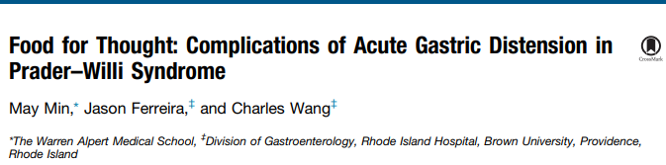
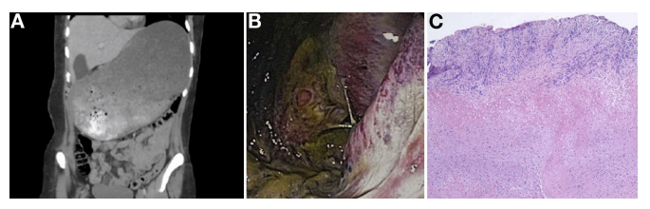
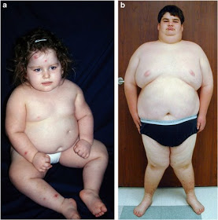
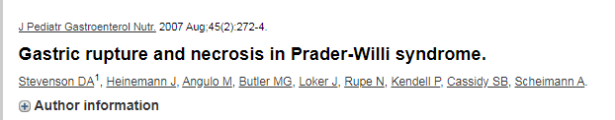
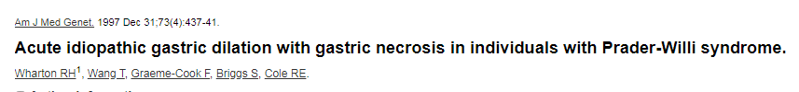
Hiperfagia entre 1-6 años de edad → Obesidad severa
Esperanza de vida 40 años
Disminución saciedad
3% mortalidad; necrosis,
perforación gastrica por sobre distensión
Priya S, Nampoothiri S, Sen P, Sripriya S. Bardet-Biedl syndrome: Genetics, molecular pathophysiology, and disease management. Indian J Ophthalmol. 2016;64(9):620–627. doi:10.4103/0301-4738.194328
Notes:
Additional features include dysmorphic facies, global cognitive impairment, behavioral abnormalities, hypotonia, delayed motor development and hormonal deficiencies such as growth hormone, hypothyroidism, hypogonadism and ghrelin abnormalities.
The PWCR on the maternal chromosome is imprinted, and therefore epigenetically silenced through methylation, leading to mono-allelic expression of the paternal genes.78 Majority of cases of PWS are caused by interstitial deletions of the paternal region of the PWCR (65–70%), while others by maternal uniparental disomy (20–30%) and mutations within the imprinting center (2–5%).
La PWCR en el cromosoma materno se imprime y, por lo tanto, se silencia epigenéticamente a través de la metilación, lo que conduce a la expresión mono-alélica de los genes paternos.

Slide 32
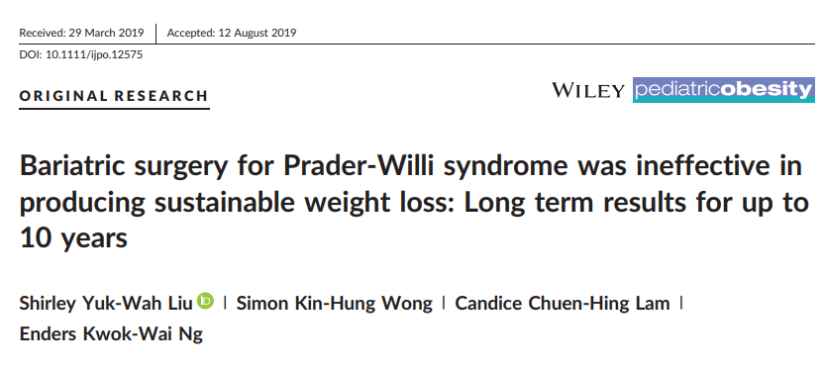
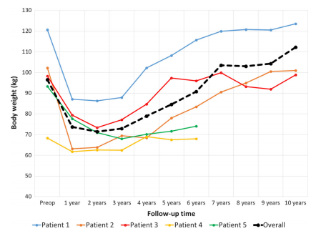
Notes:
At least 5 genes, located in the PWCR and expressed in hypothalamus, have been implicated without clarity of their roles, sin claridad de sus funciones: MKRN3 (makorin 3), MAGEL2 (MAGE-like 2), NDN (necdin), NPAP1 (nuclear pore associated protein 1), SNURF-SNRPN (SNRPN upstream reading frame – small nuclear ribosomal protein 1). 79 A recent study of pluripotent stem cells derived neurons from individuals with microdeletion in the PWCR indicates a lower expression of proconvertase 1 (PC1), previously implicated in monogenic obesity, potentially offering a unifying explanation for the phenotype

Slide 33
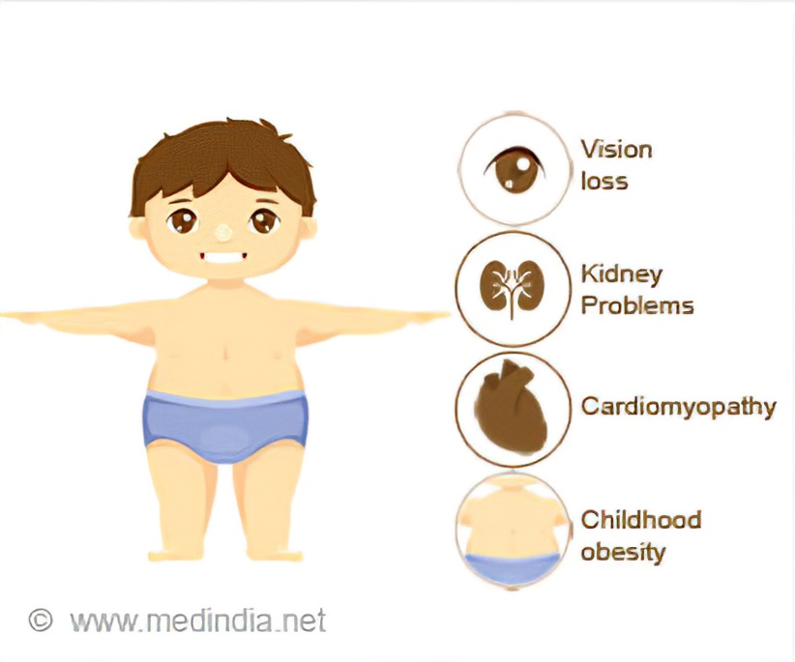
Síndrome Alström-Hallgren
Autosómico recesivo. Cr 2p13 (ALMS1)
Obesidad, acantosis, diabetes mellitus, sordera
Cardiomiopatia, talla baja, hipogonadismo, hirsutismo*, amenorrea*
Nistagmus, fotofobia progresiva
Obesidad (2 a)- adolescencia (síndrome metabólico)
Priya S, Nampoothiri S, Sen P, Sripriya S. Bardet-Biedl syndrome: Genetics, molecular pathophysiology, and disease management. Indian J Ophthalmol. 2016;64(9):620–627. doi:10.4103/0301-4738.194328
Notes:
The Alström-Hallgren syndrome, of an autosomal recessive nature, is characterized by the occurrence of neurosensory deafness and diabetes mellitus, but without polydactyly or mental retardation. In this syndrome, obesity usually occurs from two years of age, with weight often increasing to values 100% higher than normal values for age and sex.33 Another characteristic feature is the occurrence of skin changes, mainly acanthosis nigricans, arising from the chronic association between diabetes mellitus and a marked insulin resistance.

Slide 34
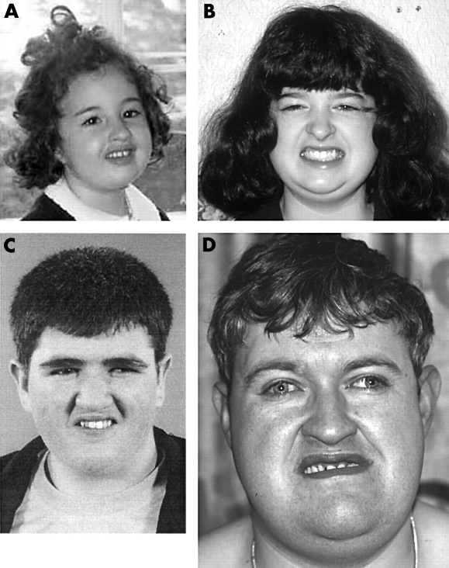
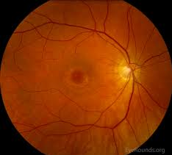
Síndrome de Cohen
Autosómico recesivo (VPS13B)
Hipotonía, retraso mental, retraso en el desarrollo
Paladar estrecho, talla baja
Micrognatia, microcefalia, dientes incisivos prominentes
Maculopatía “bulls-eye” (3 a)
Ceguera (10 a)
Obesidad (5 a)
Priya S, Nampoothiri S, Sen P, Sripriya S. Bardet-Biedl syndrome: Genetics, molecular pathophysiology, and disease management. Indian J Ophthalmol. 2016;64(9):620–627. doi:10.4103/0301-4738.194328
Notes:
The Cohen syndrome is an autosomal recessive disorder characterized by the presence in children of hypotonia, mental and pubertal retardation, gothic palate, a
characteristic facies (prominent incisor teeth, elevated nasal root, small jaw), and obesity from five years of age.35
.

Slide 35
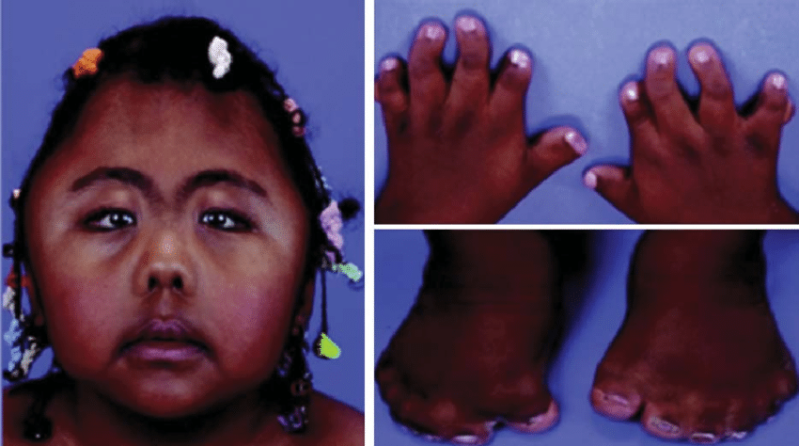
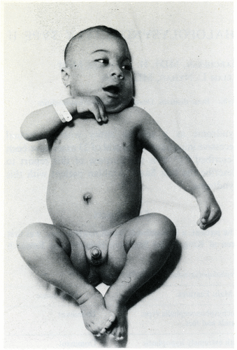
Síndrome Carpenter
Autosómico recesivo (RAB23)
40 casos
Craneosinostosis, exoftalmos
braquimesofalanges, paladar estrecho
Obesidad progresiva generalizada o troncal
Priya S, Nampoothiri S, Sen P, Sripriya S. Bardet-Biedl syndrome: Genetics, molecular pathophysiology, and disease management. Indian J Ophthalmol. 2016;64(9):620–627. doi:10.4103/0301-4738.194328
Notes:
In the Carpenter syndrome, patients develop craniosynostosis, exophthalmos, syndactyly, brachymesophalangy, and gothic palate

Slide 36
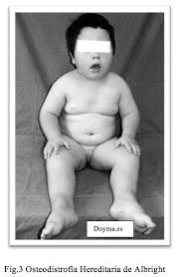
Síndrome de Albright, Osteodistrofía hereditaria
Gen GNAS1 (altera codificación proteina G)
Talla baja, cara redonda, braquimesofalanges, osificación de tejidos blandos
Manchas café con leche
Pesudohipoparatiroidismo
30% hipertiroidismo
Síndrome de Cushing (raro) hipercortisolemia
65% obesidad …..? (pble. Mutación gen MC4R → hiperfagia )
Priya S, Nampoothiri S, Sen P, Sripriya S. Bardet-Biedl syndrome: Genetics, molecular pathophysiology, and disease management. Indian J Ophthalmol. 2016;64(9):620–627. doi:10.4103/0301-4738.194328

Slide 37
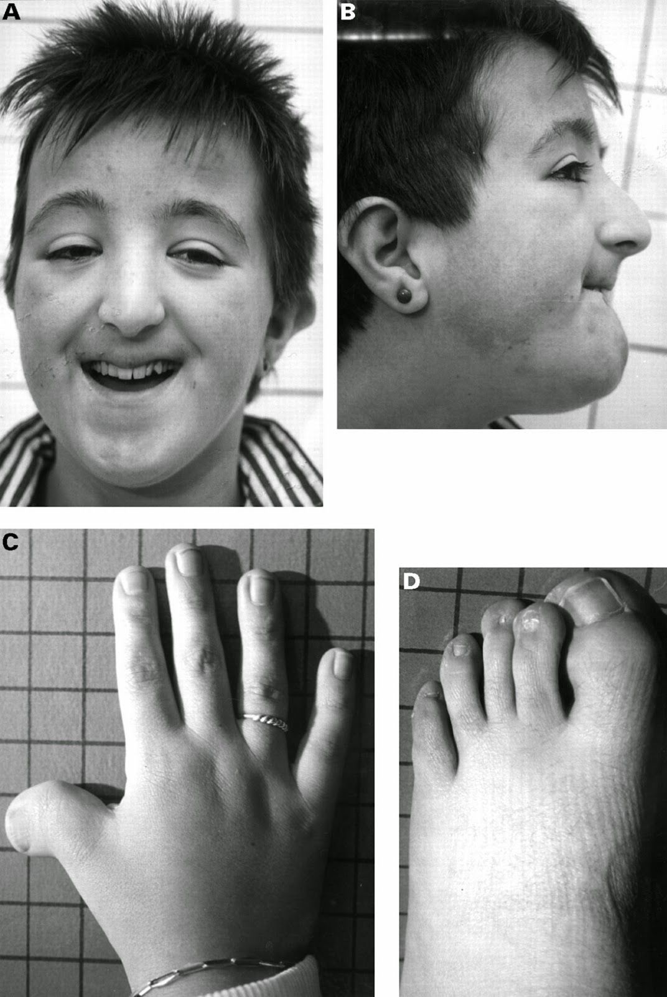
Síndrome Rubinstein-Taybi
Cromosoma 16p13.3 (50% CREBBP)
1:125,000
Microcefalia, hipertelorismo, ptosis palpebral, estrabismo micrognatia
sordera, inf respiratorias recurrentes
????....Obesidad central
52% malformaciones renales, GI (Crohn, Hirschsprung), cardiopatías
Cancer: leucemia, linfoma, meningioma …
Priya S, Nampoothiri S, Sen P, Sripriya S. Bardet-Biedl syndrome: Genetics, molecular pathophysiology, and disease management. Indian J Ophthalmol. 2016;64(9):620–627. doi:10.4103/0301-4738.194328

Slide 38
Síndrome de microdeleción 16p11.2
Retraso en el crecimiento, discapacidad intelectual, autismo,
Obesidad severa
La obesidad a menudo se manifiesta en muchos, pero no en todos los individuos, lo que sugiere penetrancia variable, o un gen específico que puede estar involucrado de manera diferencial en diferentes individuos.
1p36, 2q37, 6q16, 170.1 (Smith Magenis).
.
Notes:
This heterozygous deletion of ~593-kb region on chromosome 16 is characterized by developmental delay, intellectual disability, and/or autism spectrum disorder along with severe obesity. Walter et al noted the presence of severe obesity in children with the deletion and performed a large scale analysis using population and disease based cohorts to find an enrichment of the deletion in children and their parents with obesity.81 Further studies by Bochukova and colleagues indicate that the obesity seen in the children and adults with the 16p11.2 deletion may be mediated via SH2B1, located in the region.
In addition to PWS, and 16p11.2 deletion syndrome, several other obesity-related syndromes with chromosomal defects have been identified. Obesity is often manifested in many, but not all individuals suggesting variable penetrance, or a specific gene that may be differentially involved in different individuals. Examples include deletion of 1p36 (monosomy 1p36 syndrome), 2q37 (brachydactyly mental retardation syndrome; BDMR), 6q16 (PWS-like syndrome), 9q34 (Kleefstra syndrome), 11p13 (WAGR syndrome), and 17p11.2 (Smith Magenis syndrome; SMS).83 These syndromes may hold the clue to the single genes in the region that could further explain the biology of the disease, e.g. presence of deletion in the BDNF gene in individuals with WAGR syndrome who also presented with obesity.

Slide 39
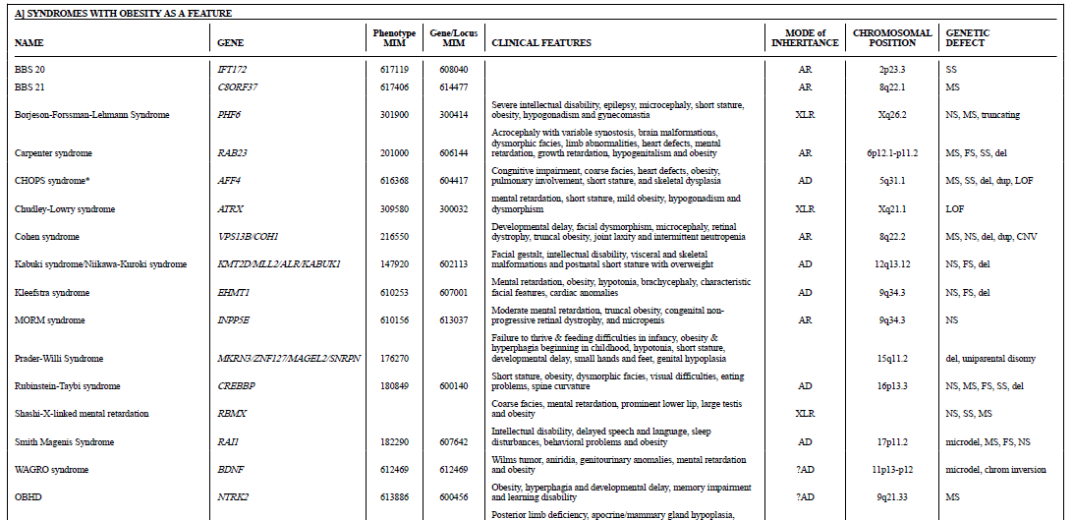
Notes:
Table 2 provides a list of syndromes known to be associated with obesity, overgrowth syndromes (sometimes confused with obesity) and syndromes where a genetic etiology is not yet elucidated. Many of these syndromes encompass neurodevelopmental abnormalities of varying spectrum. Large-scale studies, such as genome-wide association studies have shown a widespread expression of the loci associated with BMI in the brain. It is plausible that there is heretofore-unidentified shared basis of the obesity and the neurodevelopmental defect(s). However, due to the high prevalence of obesity in the society and the influence of the neuropsychological medications on weight, and the use of food as a behavior modulator, the presence of obesity may be a mere confounder. Nevertheless, neurodevelopmental defects continue to serve as important marker to consider genetic investigation in children with severe, early onset obesity. The interested reader is referred to a recent systematic review by Kaur et al.72

Slide 40
Los estudios y datos disponibles actualmente muestran claramente la importancia y la participación del componente genético en el desarrollo de la obesidad.
Cabe señalar, sin embargo, que los cambios genéticos que conducen al desarrollo de fenotipos obesos tienden a sobre expresarse como resultado de su interacción con factores ambientales.
Notes:
Currently available studies and data clearly show the significance and involvement of the genetic component in the development of obesity. It should be noted, however, that genetic changes leading to the development of obese phenotypes tend to overexpress as the result of their interaction with environmental factors.

